Slide 1
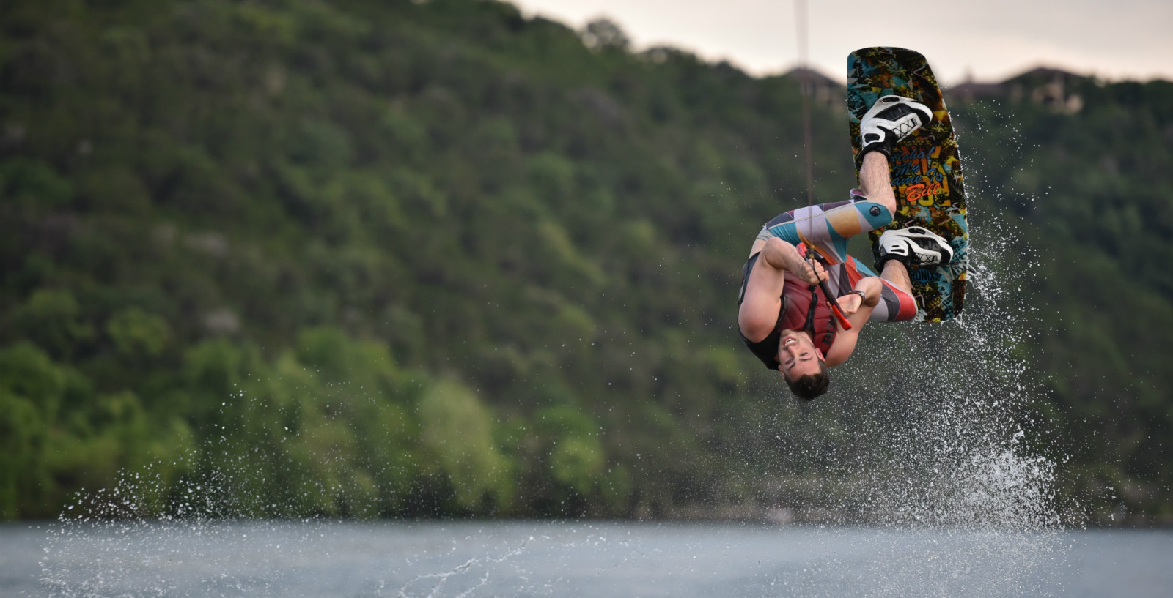
Living Courageously
2 Timothy 1:5-7

Slide 2
“The Lord challenges us to suffer persecutions and to confess him. He wants those who belong to him to be brave and fearless. He himself shows how weakness of the flesh is overcome by courage of the Spirit. This is the testimony of the apostles and in particular of the representative, administrating Spirit. A Christian is fearless.” - Tertullian

Slide 3
2 Timothy 1:5-7 (English Standard Version)
5 I am reminded of your sincere faith, a faith that dwelt first in your grandmother Lois and your mother Eunice and now, I am sure, dwells in you as well.
6 For this reason I remind you to fan into flame the gift of God, which is in you through the laying on of my hands,
7 for God gave us a spirit not of fear but of power and love and self-control.

Slide 4
Living Courageously
2 Timothy 1:5-7

Slide 5
2 Timothy 1:5-7 (English Standard Version)
5 I am reminded of your sincere faith, a faith that dwelt first in your grandmother Lois and your mother Eunice and now, I am sure, dwells in you as well.
6 For this reason I remind you to fan into flame the gift of God, which is in you through the laying on of my hands,
7 for God gave us a spirit not of fear but of power and love and self-control.

Slide 6
1. God gives His Spirit & spiritual resources to those with a sincere faith
2 Timothy 1:6-7

Slide 7
2 Timothy 1:5-7 (English Standard Version)
5 I am reminded of your sincere faith, a faith that dwelt first in your grandmother Lois and your mother Eunice and now, I am sure, dwells in you as well.
6 For this reason I remind you to fan into flame the gift of God, which is in you through the laying on of my hands,
7 for God gave us a spirit not of fear but of power and love and self-control.

Slide 8
1 Timothy 1:13-15 (English Standard Version)
13 Until I come, devote yourself to the public reading of Scripture, to exhortation, to teaching.
14 Do not neglect the gift you have, which was given you by prophecy when the council of elders laid their hands on you.
15 Practice these things, immerse yourself in them, so that all may see your progress.

Slide 9
2. Courage grows with a sense of spiritual giftedness
2 Timothy 1:6-7

Slide 10
2 Timothy 1:5-7 (English Standard Version)
5 I am reminded of your sincere faith, a faith that dwelt first in your grandmother Lois and your mother Eunice and now, I am sure, dwells in you as well.
6 For this reason I remind you to fan into flame the gift of God, which is in you through the laying on of my hands,
7 for God gave us a spirit not of fear but of power and love and self-control.

Slide 11
3. Courage grows as we access the spiritual resources God supplies
2 Timothy 1:6-7

Slide 12
Living Courageously
2 Timothy 1:5-7

