Slide 2

How You Can Help the
Missions Trip to Nicaragua
THIS WEEk We Need…
Gently Used Clothing
6 soccer balls and air pump w/ needles
$800 to cover construction costs (floor, walls, door) – Donate to the “Missions Fund”

Slide 3

1 Samuel
Chapter 16

Slide 4
1 Samuel 16:12-23 NLT
12 So Jesse sent for him. He was dark and handsome, with beautiful eyes.
And the LORD said, “This is the one; anoint him.”
13 So as David stood there among his brothers, Samuel took the flask of olive oil he had brought and anointed David with the oil. And the Spirit of the LORD came powerfully upon David from that day on. Then Samuel returned to Ramah.
14 Now the Spirit of the LORD had left Saul, and the LORD sent a tormenting spirit that filled him with depression and fear.
15 Some of Saul’s servants said to him, “A tormenting spirit from God is troubling you.

Slide 5
1 Samuel 16:12-23 NLT
16 Let us find a good musician to play the harp whenever the tormenting spirit troubles you. He will play soothing music, and you will soon be well again.”
17 “All right,” Saul said. “Find me someone who plays well, and bring him here.”
18 One of the servants said to Saul, “One of Jesse’s sons from Bethlehem is a talented harp player. Not only that—he is a brave warrior, a man of war, and has good judgment. He is also a fine-looking young man, and the LORD is with him.”

Slide 6
1 Samuel 16:12-23 NLT
19 So Saul sent messengers to Jesse to say, “Send me your son David, the shepherd.”
20 Jesse responded by sending David to Saul, along with a young goat, a donkey loaded with bread, and a wineskin full of wine.
21 So David went to Saul and began serving him. Saul loved David very much, and David became his armor bearer.
22 Then Saul sent word to Jesse asking, “Please let David remain in my service, for I am very pleased with him.”
23 And whenever the tormenting spirit from God troubled Saul, David would play the harp. Then Saul would feel better, and the tormenting spirit would go away.

Slide 8
Questions About
The Holy Spirit
Q: Will God’s Spirit Leave Me?
A: Once You Become a Christian, the Holy Spirit will never leave you.
(John 14:16; Ephesians 1:13-14)

Slide 9
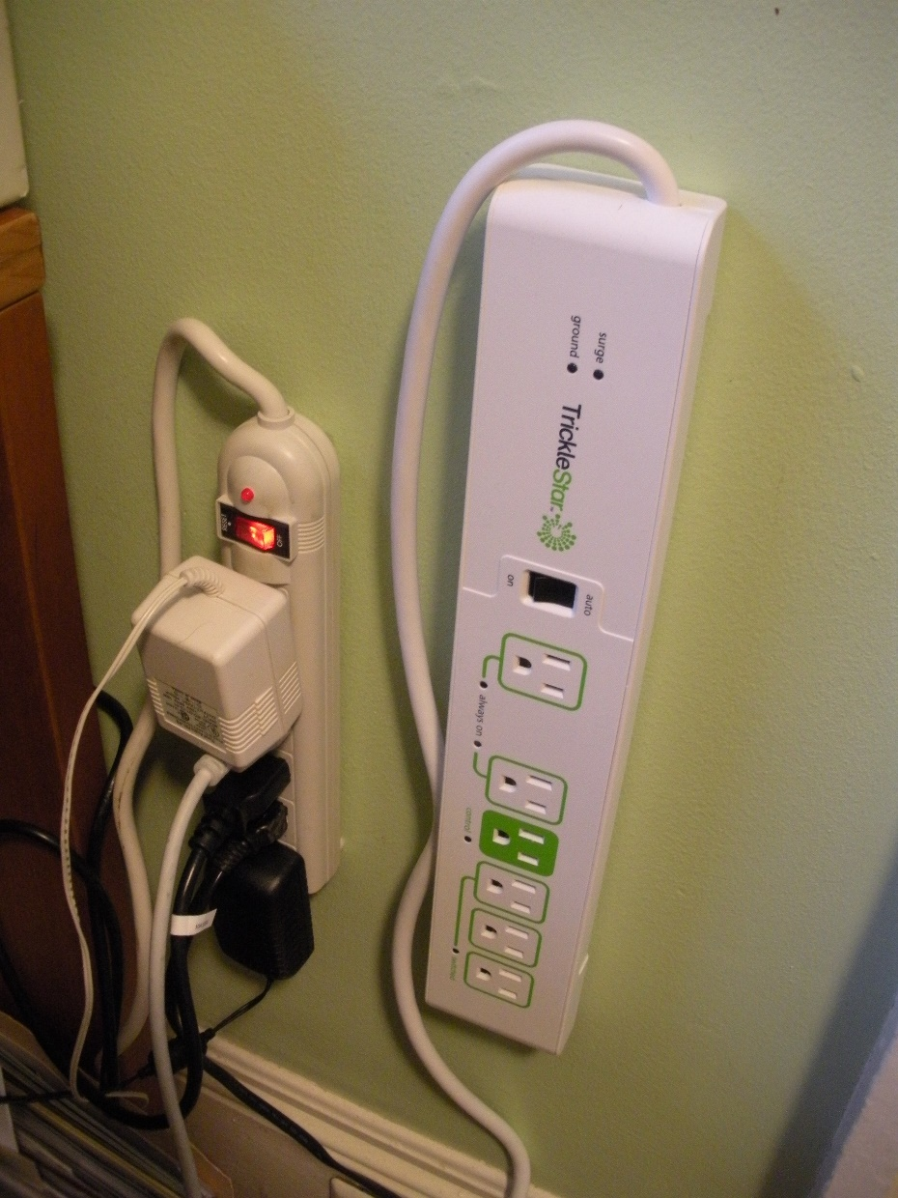
Questions About
The Holy Spirit
Is it plugged in?

Slide 10
Questions About
The Holy Spirit
Is it plugged in?
Is it switched on?

Slide 11
Questions About
The Holy Spirit
Q: If God’s Spirit is in Me, Why Don’t I Feel Close to God?
A1: I Might be Quenching the Spirit
(1 Thessalonians 5:19)

Slide 12
Questions About
The Holy Spirit
Q: If God’s Spirit is in Me, Why Don’t I Feel Close to God?
A2: I Might be Grieving the Spirit
(Ephesians 4:30)

Slide 13
Questions About
The Holy Spirit
Q: If God’s Spirit is in Me, Why Don’t I Feel Close to God?
A3: I Might Not Be Filled with the Spirit
(Ephesians 5:18; Luke 11:13)

Slide 14
Questions About
The Holy Spirit
Q: If God’s Spirit is in Me, Why Don’t I Feel Close to God?
A4: Continue to Trust and Persevere
(Colossians 1:11)

Slide 15
1 Samuel
Chapter 16

