Slide 1
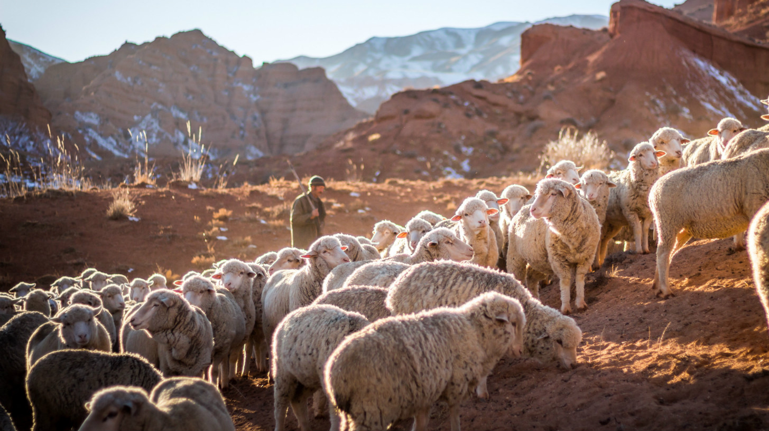
Jesus: The Good Shepherd

Slide 2
John 10:11-18 ESV
11 I am the good shepherd. The good shepherd lays down his life for the sheep.
12 He who is a hired hand and not a shepherd, who does not own the sheep, sees the wolf coming and leaves the sheep and flees, and the wolf snatches them and scatters them.
13 He flees because he is a hired hand and cares nothing for the sheep.
14 I am the good shepherd. I know my own and my own know me,

Slide 3
John 10:11-18 ESV
15 just as the Father knows me and I know the Father; and I lay down my life for the sheep.
16 And I have other sheep that are not of this fold. I must bring them also, and they will listen to my voice. So there will be one flock, one shepherd.
17 For this reason the Father loves me, because I lay down my life that I may take it up again.
18 No one takes it from me, but I lay it down of my own accord. I have authority to lay it down, and I have authority to take it up again. This charge I have received from my Father.”

Slide 4
1. “I Am the Good Shepherd” is
a Statement of Jesus’ Deity

Slide 5
Exodus 3:14 ESV
God said to Moses, “I am who I am.” And he said, “Say this to the people of Israel: ‘I am has sent me to you.’”
Ezekiel 34:11,15 ESV
13 “For thus says the Lord God: Behold, I, I myself will search for my sheep and will seek them out.”
15 “I myself will be the shepherd of my sheep, and I myself will make them lie down, declares the Lord God.”

Slide 6
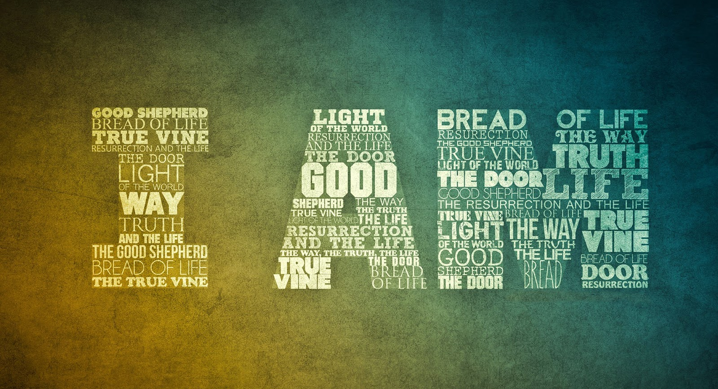

Slide 7
2. “I Am the Good Shepherd” is
an Indication of Jesus’ Exclusivity

Slide 8
Acts 4:11-12 ESV
11 This Jesus is the stone that was rejected by you, the builders, which has become the cornerstone. 12 And there is salvation in no one else, for there is no other name under heaven given among men by which we must be saved.”
John 14:6 ESV
6 Jesus said to him, “I am the way, and the truth, and the life. No one comes to the Father except through me.

Slide 9
2. “I Am the Good Shepherd” is
a Promise of Jesus’ Provision

Slide 10
John 10:11,15,17 ESV
11 I am the good shepherd. The good shepherd lays down his life for the sheep.
15 just as the Father knows me and I know the Father; and I lay down my life for the sheep.
17 For this reason the Father loves me, because I lay down my life that I may take it up again.

Slide 11
Jesus: The Good Shepherd

