Slide 2
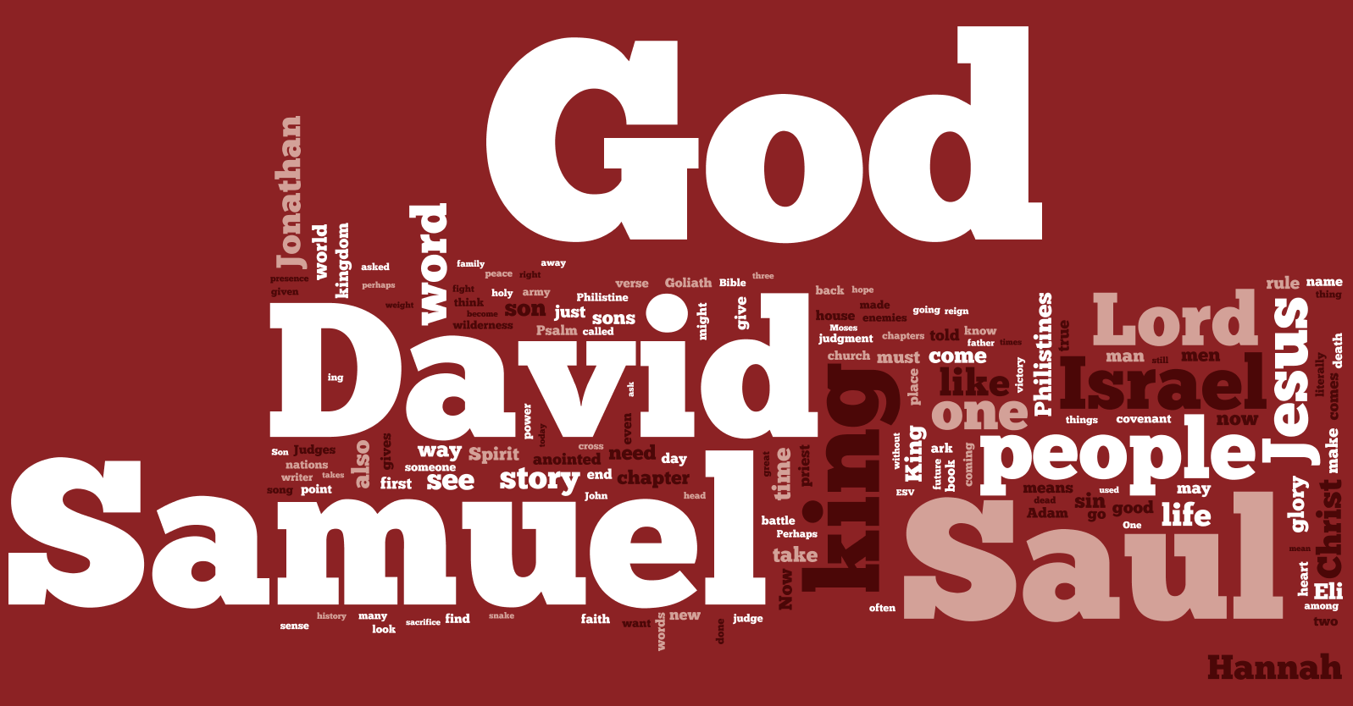
1 Samuel
Chapter 17

Slide 3
1 Samuel 17:24-26 NLT
24 As soon as the Israelite army saw him, they began to run away in fright. 25 “Have you seen the giant?” the men asked. “He comes out each day to defy Israel. The king has offered a huge reward to anyone who kills him. He will give that man one of his daughters for a wife, and the man’s entire family will be exempted from paying taxes!”
26 David asked the soldiers standing nearby, “What will a man get for killing this Philistine and ending his defiance of Israel? Who is this pagan Philistine anyway, that he is allowed to defy the armies of the living God?”

Slide 4
Faith in the Living God
Faith in the Living God Should Make a Difference in How We See Everything.
(1 Samuel 17:24-26)

Slide 5
1 Samuel 17:32-37 NLT
32 “Don’t worry about this Philistine,” David told Saul. “I’ll go fight him!”
33 “Don’t be ridiculous!” Saul replied. “There’s no way you can fight this Philistine and possibly win! You’re only a boy, and he’s been a man of war since his youth.”
34 But David persisted. “I have been taking care of my father’s sheep and goats,” he said. “When a lion or a bear comes to steal a lamb from the flock,
35 I go after it with a club and rescue the lamb from its mouth. If the animal turns on me, I catch it by the jaw and club it to death.

Slide 6
1 Samuel 17:32-37 NLT
36 I have done this to both lions and bears, and I’ll do it to this pagan Philistine, too, for he has defied the armies of the living God!
37 The Lord who rescued me from the claws of the lion and the bear will rescue me from this Philistine!”
Saul finally consented. “All right, go ahead,” he said. “And may the Lord be with you!”

Slide 7
Faith in the Living God
Looking Back in Faith Helps Us Look Forward in Faith
(1 Samuel 17:32-37)

Slide 8
1 Samuel 17:41-51 NLT
41 Goliath walked out toward David with his shield bearer ahead of him, 42 sneering in contempt at this ruddy-faced boy.
43 “Am I a dog,” he roared at David, “that you come at me with a stick?” And he cursed David by the names of his gods.
44 “Come over here, and I’ll give your flesh to the birds and wild animals!” Goliath yelled.
45 David replied to the Philistine, “You come to me with sword, spear, and javelin, but I come to you in the name of the Lord of Heaven’s Armies—the God of the armies of Israel, whom you have defied.

Slide 9
1 Samuel 17:41-51 NLT
46 Today the Lord will conquer you, and I will kill you and cut off your head. And then I will give the dead bodies of your men to the birds and wild animals, and the whole world will know that there is a God in Israel!
47 And everyone assembled here will know that the Lord rescues his people, but not with sword and spear. This is the Lord’s battle, and he will give you to us!”
48 As Goliath moved closer to attack, David quickly ran out to meet him.
49 Reaching into his shepherd’s bag and taking out a stone, he hurled it with his sling and hit the Philistine in the forehead. The stone sank in, and Goliath stumbled and fell face down on the ground.

Slide 10
1 Samuel 17:41-51 NLT
50 So David triumphed over the Philistine with only a sling and a stone, for he had no sword.
51 Then David ran over and pulled Goliath’s sword from its sheath. David used it to kill him and cut off his head.

Slide 11
Faith in the Living God
In God’s Economy, the Weak are Strong.
(1 Samuel 17:41-51)

Slide 12
1 Samuel
Chapter 16

