Slide 2
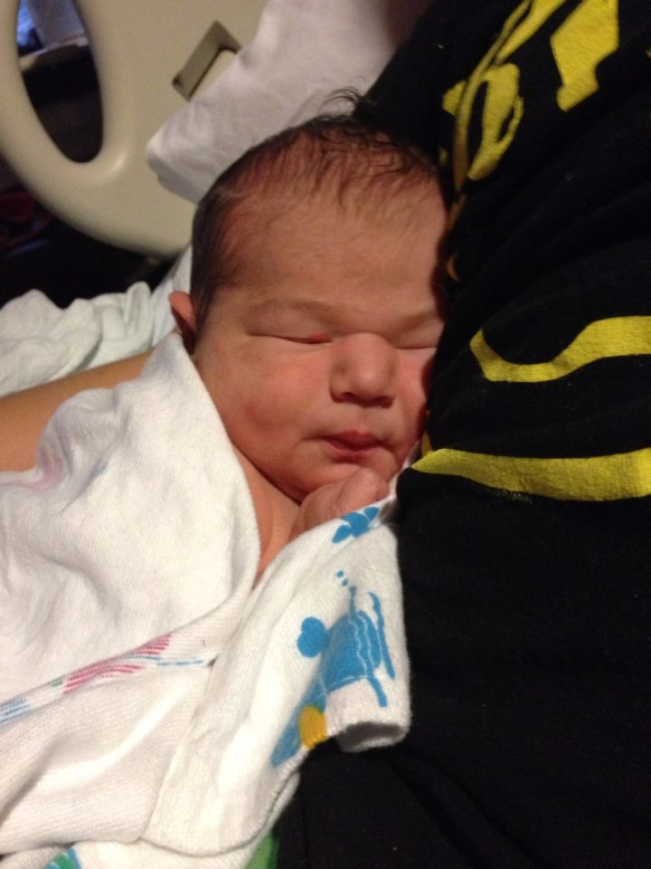
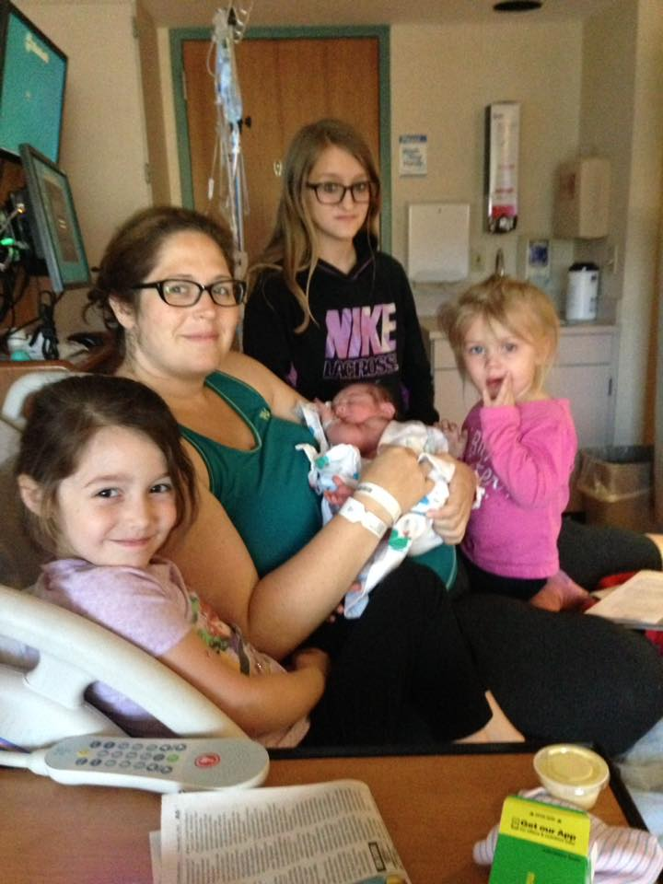
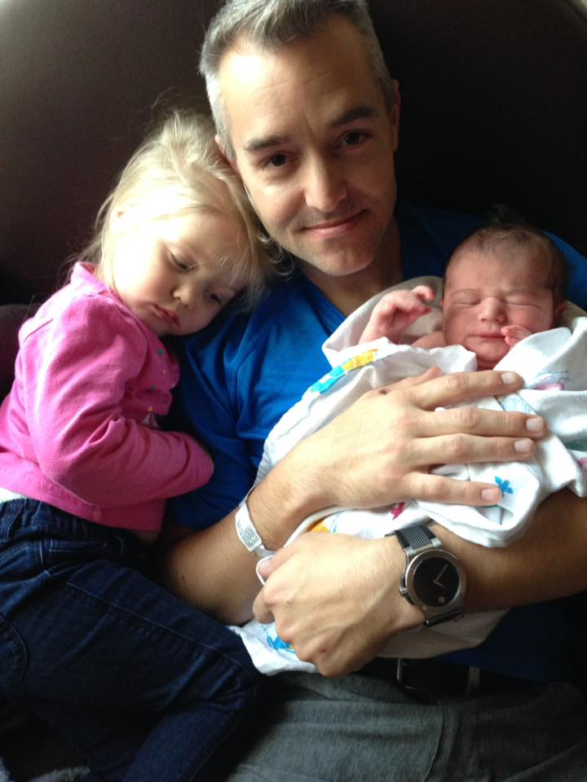
Silas Wayne Hays
5/6/2017 3:23am
9# even, 22" long
Want to Help With Meals? Text or Call Linda Burlile @ 614-529-8754 or speak with her today. Meals start tomorrow.

Slide 4
Luke 2:22-38 HCSB (Holman Christian Standard Bible)
21 When the eight days were completed for His circumcision, He was named Jesus—the name given by the angel before He was conceived. 22 And when the days of their purification according to the law of Moses were finished, they brought Him up to Jerusalem to present Him to the Lord
23 just as it is written in the law of the Lord: Every firstborn male will be dedicated to the Lord)
24 and to offer a sacrifice (according to what is stated in the law of the Lord: a pair of turtledoves or two young pigeons).

Slide 5
Luke 2:22-38 HCSB
25 There was a man in Jerusalem whose name was Simeon. This man was righteous and devout, looking forward to Israel’s consolation, and the Holy Spirit was on him.
26 It had been revealed to him by the Holy Spirit that he would not see death before he saw the Lord’s Messiah.
27 Guided by the Spirit, he entered the temple complex. When the parents brought in the child Jesus to perform for Him what was customary under the law,

Slide 6
Luke 2:22-38 HCSB
28 Simeon took Him up in his arms, praised God, and said:
29 Now, Master, You can dismiss Your slave in peace, as You promised.
30 For my eyes have seen Your salvation.
31 You have prepared itin the presence of all peoples—
32 a light for revelation to the Gentiles and glory to Your people Israel.
33 His father and mother were amazed at what was being said about Him.

Slide 7
Luke 2:22-38 HCSB
34 Then Simeon blessed them and told His mother Mary: “Indeed, this child is destined to cause the fall and rise of many in Israel and to be a sign that will be opposed—
35 and a sword will pierce your own soul—that the thoughts of many hearts may be revealed.”
36 There was also a prophetess, Anna, a daughter of Phanuel, of the tribe of Asher. She was well along in years, having lived with her husband seven years after her marriage,

Slide 8
Luke 2:22-38 HCSB
37 and was a widow for 84 years. She did not leave the temple complex, serving God night and day with fasting and prayers.
38 At that very moment, she came up and began to thank God and to speak about Him to all who were looking forward to the redemption of Jerusalem.

Slide 9
Life Lessons from
Anna the Prophetess

Slide 10
*Be Devoted to Pursuing a
Deep Walk with God
Notes:
Verse 37: She did not leave the temple complex, serving God night and day. --- 2 Cor 11:3 But I am afraid that as the serpent deceived Eve by his cunning, your thoughts will be led astray from a sincere and pure devotion to Christ. + Most likely a women of the Word….she new the prophecies concerning the Messiah..daily looking forward to the coming of the savior.

Slide 11
*Be a Faithful Witness to the
Saving Power of Jesus Christ
Notes:
Vs 38 At that very moment, she came up and began to thank God and to speak about Him to all who were looking forward to the redemption of Jerusalem. Acts 1:8 -- But you will receive power when the Holy Spirit has come upon you, and you will be my witnesses in Jerusalem and in all Judea and Samaria, and to the end of the earth.” – God Calls ALL BELIEVERS TO BE HIS WITNESSES

Slide 12
*God Loves to Use Nobodies
Notes:
Anna’s husband died early in their marriage; seemingly no children to speak of; --- in that society totally dependent on the kindness and generosity of others. +++ PRINT OUT OF EXAMPLES OF “NOBODIES” -- then, 1 Corinthians 1:26-29 (God using nobodies shames the wise). TRIP LEE [video] – 2 Corinthians 12:7-10 (Paul mentions four purposes for his weaknesses. --“To keep me from becoming conceited” (verse 7). “[Christ’s] power is made perfect in weakness” (verse 9). “So that the power of Christ may rest upon me” (verse 9). “When I am weak, then I am strong” (verse 10).

Slide 13
*Praying and Fasting are ways
to serve God and His Church
Notes:
Pray for others …God works through prayer and accomplishs James 5:16-17;

Slide 14
*It’s not about Your Age,
It’s about Your Availability
Notes:
Caleb 80 years old take the land; Moses was 80 when God used him to deliver Isreal from Eqyption Captivity ….Old – Psalm 71:17-18 ; Young – 1 Timothy 4:13

