Slide 1
How You Can Help the
Missions Trip to Nicaragua
By Sunday, June 4 We Need…
Gently Used Clothing
6 soccer balls and air pump w/ needles
$800 to cover construction costs (floor, walls, door) – Donate to the “Missions Fund”

Slide 4
The Day Jesus Return

Slide 5
Luke 17:20-37 NLT (New Living Translation)
20 One day the Pharisees asked Jesus, “When will the Kingdom of God come?”
Jesus replied, “The Kingdom of God can’t be detected by visible signs.
21 You won’t be able to say, ‘Here it is!’ or ‘It’s over there!’ For the Kingdom of God is already among you.”
22 Then he said to his disciples, “The time is coming when you will long to see the day when the Son of Man returns, but you won’t see it.

Slide 6
Luke 17:20-37 NLT (New Living Translation)
23 People will tell you, ‘Look, there is the Son of Man,’ or ‘Here he is,’ but don’t go out and follow them.
24 For as the lightning flashes and lights up the sky from one end to the other, so it will be on the day when the Son of Man comes.
25 But first the Son of Man must suffer terribly and be rejected by this generation.
26 “When the Son of Man returns, it will be like it was in Noah’s day.

Slide 7
Luke 17:20-37 NLT (New Living Translation)
27 In those days, the people enjoyed banquets and parties and weddings right up to the time Noah entered his boat and the flood came and destroyed them all.
28 “And the world will be as it was in the days of Lot. People went about their daily business—eating and drinking, buying and selling, farming and building—
29 until the morning Lot left Sodom. Then fire and burning sulfur rained down from heaven and destroyed them all.
30 Yes, it will be ‘business as usual’ right up to the day when the Son of Man is revealed.

Slide 8
Luke 17:20-37 NLT (New Living Translation)
31 On that day a person out on the deck of a roof must not go down into the house to pack. A person out in the field must not return home.
32 Remember what happened to Lot’s wife!
33 If you cling to your life, you will lose it, and if you let your life go, you will save it.
34 That night two people will be asleep in one bed; one will be taken, the other left.

Slide 9
Luke 17:20-37 NLT (New Living Translation)
35 Two women will be grinding flour together at the mill; one will be taken, the other left.”
37 “Where will this happen, Lord?” the disciples asked.
Jesus replied, “Just as the gathering of vultures shows there is a carcass nearby, so these signs indicate that the end is near.”
** The best Greek manuscripts do not contain verse 36 so many translations leave it out.

Slide 10
* The Day Jesus Returns will be
Obvious to Everyone (17:22-24)

Slide 11
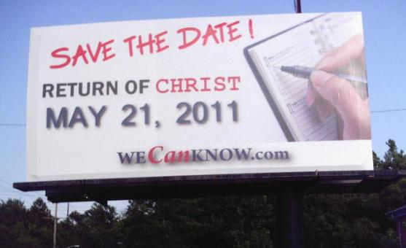
* The Day Jesus Returns
will be Unexpected (17:25-30)

Slide 12
* The Day Jesus Returns
will be Revealing (17:31-35)

Slide 13
“The sin of worldliness is a preoccupation with the things of this temporal life. It’s accepting and going along with the views and practices of society around us without discerning if they are biblical. I believe that the key to our tendencies toward worldliness
lies primarily in the two words ‘going along’. We simply go along with the values and practices of society.”

Slide 14
1 John 2:15-17 ESV (English Standard Version)
15 Do not love the world or the things in the world. If anyone loves the world, the love of the Father is not in him.
16 For all that is in the world—the desires of the flesh and the desires of the eyes and pride of life—is not from the Father but is from the world.
17 And the world is passing away along with its desires, but whoever does the will of God abides forever.

Slide 15
Combating Worldliness…
Saying NO to..
Whatever weakens your reason
Whatever impairs the tenderness of your conscience
Whatever obscures your sense of God
Whatever increases the authority of your body over your mind
Whatever takes away your relish for spiritual things…that to you is sin, no matter how innocent it is in itself.
- Susannah Wesley in a letter to her son, John.

Slide 16
Questions to ask yourself to discern
if the activity is glorifying to God or
might be worldly (from Rick Whitney, in “Not Loving the
World” GCLI article)
Does it tempt you to sin?
Is it good for you or bad for you?
Does it enslave you?
Does it honor and glorify God?
Does it encourage others? Would you do it or watch it if you had company?
Does it cause your brother to stumble?
Are your motives pure when you are involved with it?

