Slide 1
#Jesus
Following the Life of Jesus

Slide 2
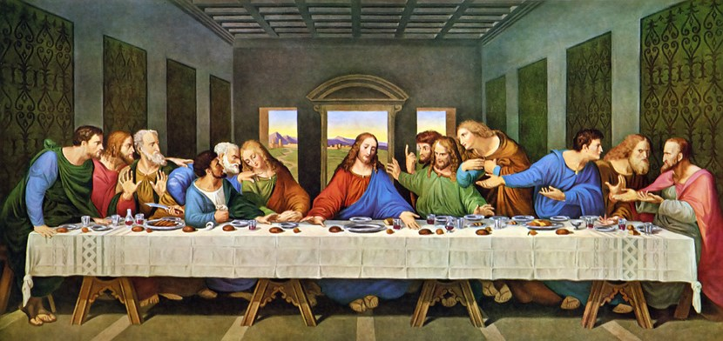
What Happened at the Cross?
Scene 1: The Last Supper (Matthew 26:26-29)
#Jesus

Slide 3
Matthew 26:26-29 English Standard Version
26 Now as they were eating, Jesus took bread, and after blessing it broke it and gave it to the disciples, and said, “Take, eat; this is my body.”
27 And he took a cup, and when he had given thanks he gave it to them, saying, “Drink of it, all of you,
28 for this is my blood of the covenant, which is poured out for many for the forgiveness of sins.
29 I tell you I will not drink again of this fruit of the vine until that day when I drink it new with you in my Father's kingdom.”

Slide 4
What Happened at the Cross?
Scene 1: The Last Supper (Matthew 26:26-29)
#Jesus

Slide 5
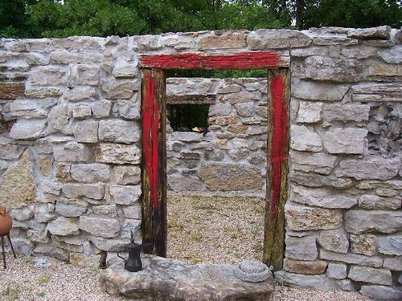
What Happened at the Cross?
Scene 1: The Last Supper (Matthew 26:26-29)
Substitution:
Jesus is our substitute. He died the death we deserve.
Before the cross, we were headed to eternal death; because of the cross, we now have eternal life.
#Jesus

Slide 6
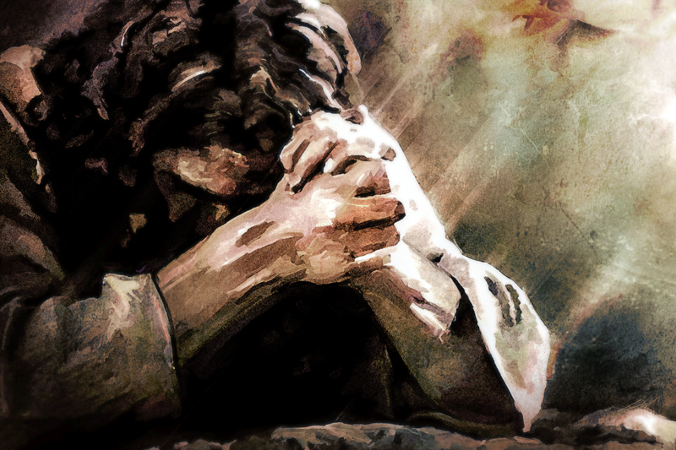
What Happened at the Cross?
Scene 2: The Garden (Matthew 26:36-46)
#Jesus

Slide 7
Matthew 26:36-46 English Standard Version
36 Then Jesus went with them to a place called Gethsemane, and he said to his disciples, “Sit here, while I go over there and pray.”
37 And taking with him Peter and the two sons of Zebedee, he began to be sorrowful and troubled.
38 Then he said to them, “My soul is very sorrowful, even to death; remain here, and watch with me.”
39 And going a little farther he fell on his face and prayed, saying, “My Father, if it be possible, let this cup pass from me; nevertheless, not as I will, but as you will.”

Slide 8
Matthew 26:36-46 English Standard Version
40 And he came to the disciples and found them sleeping. And he said to Peter, “So, could you not watch with me one hour?
41 Watch and pray that you may not enter into temptation. The spirit indeed is willing, but the flesh is weak.”
42 Again, for the second time, he went away and prayed, “My Father, if this cannot pass unless I drink it, your will be done.”
43 And again he came and found them sleeping, for their eyes were heavy.

Slide 9
Matthew 26:36-46 English Standard Version
44 So, leaving them again, he went away and prayed for the third time, saying the same words again.
45 Then he came to the disciples and said to them, “Sleep and take your rest later on. See, the hour is at hand, and the Son of Man is betrayed into the hands of sinners.
46 Rise, let us be going; see, my betrayer is at hand.”

Slide 10
What Happened at the Cross?
Scene 2: The Garden (Matthew 26:36-46)
Propitiation:
The wrath of God's holiness was satisfied as it was poured out on Jesus when He became sin for us.
Before the cross, we were afraid of God; because of the cross, we are now friends of God.
#Jesus

Slide 11
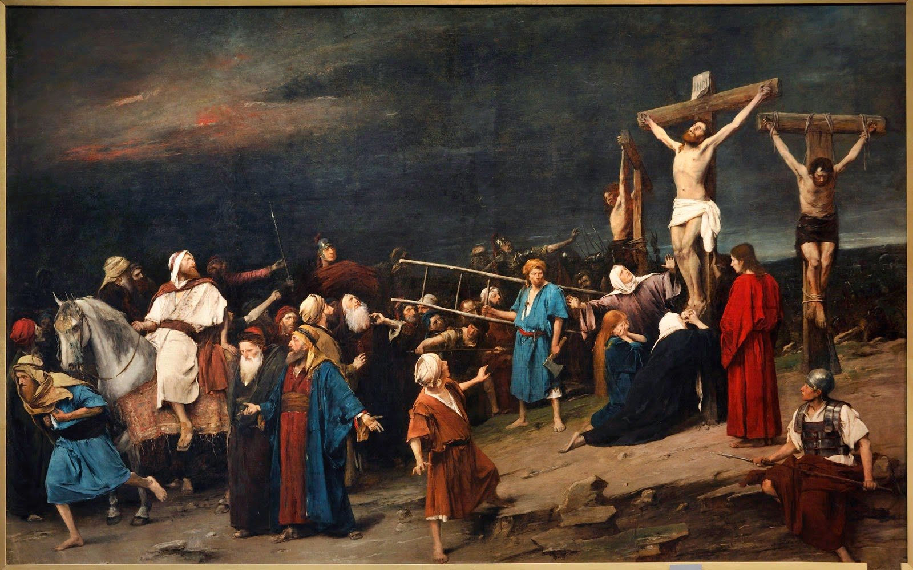
What Happened at the Cross?
Scene 3: The Cross (Matthew 27:45-54)
#Jesus

Slide 12
Matthew 27:45-54 English Standard Version
45 Now from the sixth hour there was darkness over all the land until the ninth hour.
46 And about the ninth hour Jesus cried out with a loud voice, saying, “Eli, Eli, lema sabachthani?” that is, “My God, my God, why have you forsaken me?”
47 And some of the bystanders, hearing it, said, “This man is calling Elijah.”
48 And one of them at once ran and took a sponge, filled it with sour wine, and put it on a reed and gave it to him to drink.

Slide 13
Matthew 27:45-54 English Standard Version
49 But the others said, “Wait, let us see whether Elijah will come to save him.” 50 And Jesus cried out again with a loud voice and yielded up his spirit.
51 And behold, the curtain of the temple was torn in two, from top to bottom. And the earth shook, and the rocks were split.
52 The tombs also were opened. And many bodies of the saints who had fallen asleep were raised,

Slide 14
Matthew 27:45-54 English Standard Version
53 and coming out of the tombs after his resurrection they went into the holy city and appeared to many.
54 When the centurion and those who were with him, keeping watch over Jesus, saw the earthquake and what took place, they were filled with awe and said, “Truly this was the Son of God!”

Slide 15
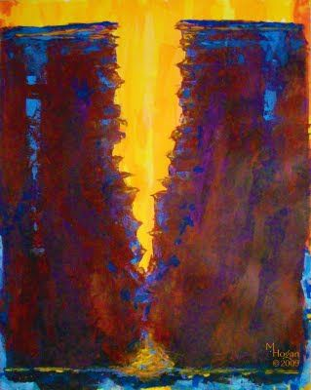
What Happened at the Cross?
Scene 3: The Cross (Matthew 27:45-54)
Reconciliation:
Jesus was suffering separation from God for our reconciliation. Before the cross, we were cast out of God's presence; because of the cross, we are now invited into God's presence.
#Jesus

Slide 16
#Jesus
Following the Life of Jesus

