Slide 1
#Jesus
Following the Life of Jesus

Slide 2
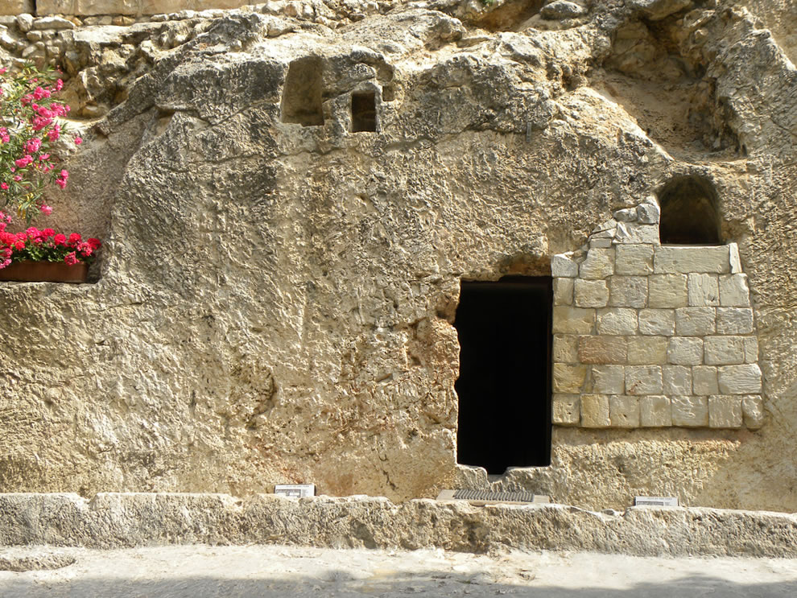
The Resurrection is the Core of Our Faith
FAITH

Slide 3
1 Corinthians 15:3-9, 14-20 New Living Translation
3 I passed on to you what was most important and what had also been passed on to me. Christ died for our sins, just as the Scriptures said.
4 He was buried, and he was raised from the dead on the third day, just as the Scriptures said.
5 He was seen by Peter and then by the Twelve.
6 After that, he was seen by more than 500 of his followers at one time, most of whom are still alive, though some have died.

Slide 4
1 Corinthians 15:3-9, 14-20 New Living Translation
7 Then he was seen by James and later by all the apostles.
8 Last of all, as though I had been born at the wrong time, I also saw him.
9 For I am the least of all the apostles. In fact, I’m not even worthy to be called an apostle after the way I persecuted God’s church.

Slide 5
1 Corinthians 15:3-9, 14-20 New Living Translation
14 And if Christ has not been raised, then all our preaching is useless, and your faith is useless.
15 And we apostles would all be lying about God—for we have said that God raised Christ from the grave. But that can’t be true if there is no resurrection of the dead.
16 And if there is no resurrection of the dead, then Christ has not been raised.
17 And if Christ has not been raised, then your faith is useless and you are still guilty of your sins.

Slide 6
1 Corinthians 15:3-9, 14-20 New Living Translation
18 In that case, all who have died believing in Christ are lost!
19 And if our hope in Christ is only for this life, we are more to be pitied than anyone in the world.
20 But in fact, Christ has been raised from the dead. He is the first of a great harvest of all who have died.

Slide 7
Faith’s Battle with Doubt
(John 20:19-25)
FAITH

Slide 8
Sources of Doubt
A Right of Passage into Maturity
A Lack of Information (Ignorance)
A Product of Moral Choices

Slide 9
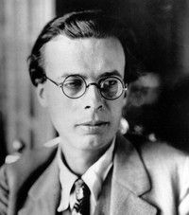
“I had motives for not wanting the world to have a meaning; and consequently assumed that it had none, and was able without any difficulty to find satisfying reasons for this assumption. The philosopher who finds no meaning in the world is not concerned exclusively with a problem in pure metaphysics. He is also concerned to prove that there is no valid reason why he personally should not do as he wants to do.
― Aldous Huxley, Ends and Means

Slide 10
For myself, as no doubt for most of my friends, the philosophy of meaninglessness was essentially an instrument of liberation from a certain system of morality. We objected to the morality because it interfered with our sexual freedom. The supporters of this system claimed that it embodied the meaning - the Christian meaning, they insisted - of the world.
― Aldous Huxley, Ends and Means

Slide 11
There was one admirably simple method of confuting these people and justifying ourselves in our erotic revolt: we would deny that the world had any meaning whatever.”
― Aldous Huxley, Ends and Means

Slide 12
Sources of Doubt
Religious Disappointment
(Thomas in John 20)

Slide 13
John 20:19-25 New Living Translation
19 That Sunday evening the disciples were meeting behind locked doors because they were afraid of the Jewish leaders. Suddenly, Jesus was standing there among them! “Peace be with you,” he said.
20 As he spoke, he showed them the wounds in his hands and his side. They were filled with joy when they saw the Lord!
21 Again he said, “Peace be with you. As the Father has sent me, so I am sending you.”
22 Then he breathed on them and said, “Receive the Holy Spirit.

Slide 14
John 20:19-25 New Living Translation
23 If you forgive anyone’s sins, they are forgiven. If you do not forgive them, they are not forgiven.”
Jesus Appears to Thomas
24 One of the twelve disciples, Thomas (nicknamed the Twin), was not with the others when Jesus came.
25 They told him, “We have seen the Lord!”
But he replied, “I won’t believe it unless I see the nail wounds in his hands, put my fingers into them, and place my hand into the wound in his side.”

Slide 15
The Assurance of Faith
(John 20:26-29)
FAITH

Slide 16
John 20:26-29 New Living Translation
26 Eight days later the disciples were together again, and this time Thomas was with them. The doors were locked; but suddenly, as before, Jesus was standing among them. “Peace be with you,” he said.
27 Then he said to Thomas, “Put your finger here, and look at my hands. Put your hand into the wound in my side. Don’t be faithless any longer. Believe!”
28 “My Lord and my God!” Thomas exclaimed.
29 Then Jesus told him, “You believe because you have seen me. Blessed are those who believe without seeing me.”

Slide 17
The Invitation of Faith
(John 20:30-31)
FAITH

Slide 18
John 20:30-31 New Living Translation
30 The disciples saw Jesus do many other miraculous signs in addition to the ones recorded in this book.
31 But these are written so that you may believe that Jesus is the Messiah, the Son of God, and that by believing in him you will have life by the power of his name.

Slide 19
#Jesus
Following the Life of Jesus

