Slide 1
#Jesus
Following the Life of Jesus
Notes:
Good morning
Today I am continuing the #Jesus series that Greg started all the way back on January 8. If you’de like to get caught up on the last eleven messages you can certainly visit the darbycreek.org website and click on the weekly sermons icon. Last week Greg shared about the types of storms we encounter in life storms of correction and storms of perfection pointing to the event of Jesus walking on the water towards the disciples being bounced around in one of their fishing boats during a storm Certainly Saint Peter walking on the water, even for a moment was a remarkable feat of faith , helping to perfect his faith. But for me what was interesting is that once the seas calmed and Jesus joined them in the boat it was the first time we have a record of the disciples worshiping Him It took a storm and saving a friend from drowning that opened the eyes to who Jesus was really was.

Slide 2
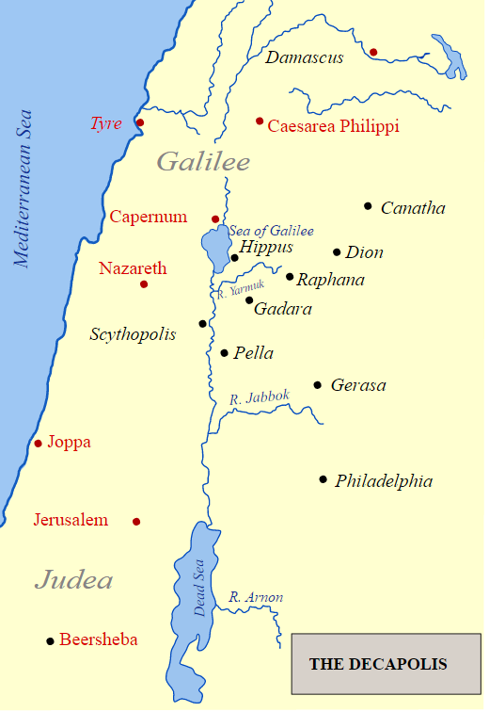
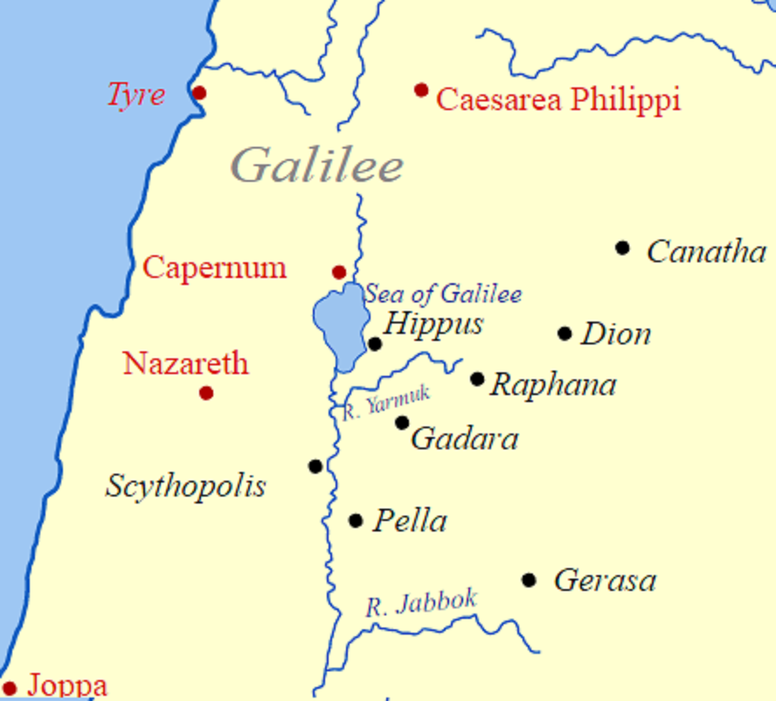
Notes:
This was at least the second storm the disciples sailed through together. An earlier account, recorded in the Gospels of Matthew and Mark, the disciples were crossing the sea and Jesus had fallen asleep after an exhausting day healing and teaching. The disciples woke him, completely bewilder how he could sleep during a terrific storm. He simply told the the weather to “be still.” and it was. At that point, the disciples notes “he ain;t from around here” or more precifsley, “who is this? Even the wind and the waves obey Him.”: Mark notes they were still terrifies at that idea.
As the boat lands in the region of Gerasense, we begin Chapter 5 of Mark. Jesus frees a man from demon possession, and that man, being very grateful begs Jesus to join his band of disciples. Jesus tells him “no, but instead to go hom and tell his family and friends what God has done for him. Meanwhile, because of a pretty incredible story you’ll need to read, the city sees the freed man and begs Jesus to leave, so Jesus and the few disciples hop back in the boat and sail back towards Capernium. The freed man does go across the Decapolis, cities named in black telling people “how much Jesus had done for him. And all the people were amazed.”:
Before we jump into today’s teaching, lets pray God’s blessing on the teaching today

Slide 3
#Jesus
Following the Life of Jesus
Notes:
Any of you who may have heard me teach in the past know I usually stick to the later books of the New Testament in order to encourage us to ways we should live together as the church. Whether it’s involving students or post-grad individuals, the Christian life is one we should be living together and following the directions laid out in the epistles.
So for me, this section of scripture is difficult to read and then figure out how to apply to Doug Cornelius, business man, husband, father, or Darby Creeker. The next two stories are really incredible pieces of history, demonstrating the kind of person Jesus was, but as we peel back the onion together, we will have three nuggets we should walk away with…the deeper understanding of what is going on in the passage is just a bonus! So let’s jump in!

Slide 4
Mark 5:21-43 English Standard Version
“²¹ And when Jesus had crossed again in the boat to the other side, a great crowd gathered about Him, and he was beside the sea. ²² Then came one of the rulers of the synagogue, Jairus by name, and seeing Him, he fell at His feet ²³ and implored Him earnestly, saying, “My little daughter is at the point of death. Come and lay your hands on her, so that she may be made well and live.” ²⁴ And He went with him.
And a great crowd followed Him and thronged about Him.
Notes:
Vs-21, again, just left the region of Gerasenes, and presumably landed near Capernium. As Jesus disembarks, there is a crowd of people waiting for him, including JEYE-RUS, a ruler of the Synagogue. (There’s a lot of masculine pronouns here, so I’ve highlighted the Jesus pronouns for you.
Vs- 22 Now the, before this encounter, Jesus had entered a Synagogue and met a man with a shriveled hand. IT was the Sabbath day, and by law, no work was to be done on the Sabbath. Moses had recorded many examples of work for the Jewish people, but just as we see in our own lives new technologies, ideas, and activities spring up and as the world changes, the application of law and such must be addressed. I can tell you that no where in Mosaic law a statement of “Thou shall not heal on the Sabbath” but somewhere along the line, the Pharisees had developed such a rule. With a broken heart because the people were more concerned about breaking a rule made to encourage and refresh man than they were the well-being of another man, Jesus went ahead and healed this man’s hand. AT that, various leaders within the synagogue system began to plot how to Kill Jesus.
Now Jairus was basically a manager of one of the synagogues. HE cared for the Synagogue campus if you will, and probably maintained the schedule of prayer and teaching services as well. I would suggest he was very much aware of the attitude the Jewish leadership had of this teacher from Gallilee. Perhaps even his highly esteemed job as a Synagogue Ruler was at risk if he were seen speaking to Jesus. We read:
Any parent here has felt bad for a child suffering with a cold, but how much more for a child with chronic, degrading conditions, even to the point of death. Such a sense of desperation, not simply because you don’t want to lose a child, but because you don’t want your child to miss out on a full life.

Slide 5
Mark 5:21-43 English Standard Version
And there was a woman who had had a discharge of blood for twelve years, ²⁶ and who had suffered much under many physicians, and had spent all that she had, and was no better but rather grew worse. ²⁷ She had heard the reports about Jesus and came up behind Him in the crowd and touched his garment. ²⁸ For she said, “If I touch even His garments, I will be made well.” ²⁹ And immediately the flow of blood dried up, and she felt in her body that she was healed of her disease. ³⁰ And Jesus, perceiving in Himself that power had gone out from Him, immediately turned about in the crowd and said, “Who touched my garments?”
Notes:
Vs 25 – within this crowd that thronged Jesus was a sick woman. And actually under Mosaic law, spelled out clearly in Leviticus 15, there is clear prohinition for this woman to be out within the reach of people. Because of discharging disease, she is unclean. She is unclean for up to 7 days after the last flow of blood, and then on the 8th day, she has to be cleared by the priest before she can hug friends and family again!....and she’s lived that way for twelve years, perhaps since the birthday of Jairus’ daughter.
Verse 26 – who knew healthcare had been such a topic for so long! I would suggest that since Mark mentions she spent all that she had on physicians, she had, at one time, been fairly well off…for since she was unclean, everything she would create, bake or sew would be unclean and it would be hard to make aliving that way. Unlike some others that are healed by Jesus, we don’t read that she was a beggar or anything, so she has spent great personal wealth on medical help that not only didn’t heal her, but didn’t even slow the progression of the condition.
Vs-27 She’d heard the reports of Jesus healing people…perhaps even the young man of Nain where he simply told him to get up without touching him. As a Rabbi/Teacher, Jesus may have worn the rabbinical coat that made him stand out from behind in the crowd, for this deparate woman dare not come face to face with such a great man for fear of him running into her and becoming unclean, so she only wants to reach up and touch the back side of his clothing.
Vs 28 – I WILL be made well. In a later New Testament book called Hebrews, we read in Chapter 11: verse 1: Now faith is being sure of what we hope for and certain of what we do not see. This woman had faith in Jesus. And this wasn;t necessarily a faith based on the latest news…knowing this person is a woman, she has completed her torah training in time for her bat mitzvah. In that training, she surely would have come across Moses’ writing in Exodus 15:26 “If you listen carefully to the voice of the Lord your God and do what is right in his eyes, if you pay attention to his commands and keep all his decrees, I will not bring on you any of the diseases I brought on the Egyptians, for I am the Lord, who heals you.” And perhaps pressed on by knowing those words of God, she pursues Jesus
Vs 29- she literally feels her body change. Jesus’ response to faith is complete. She didn’t start getting a bit better and as she convalessed became whole…she could now start her 7 days to benig cleaned!
Vs 30- Jesus doesn’t accidently help us. He knows it and is involved. The old song “From a distance, God is watching us” use to make me cringe. Spiritual people loved it…but isn’t true…perposfully and personally, God is with us.
Anyone here ever been thronged?

Slide 6
Notes:
This is a great picture of being thronged. Any good preacher always figures out a way to work the buckeyes into their message, and this is my brother and I after the Michigan game this past fall. Obviusly, we were being touched all over

Slide 7
Mark 5:21-43 English Standard Version
³¹ And his disciples said to Him, “You see the crowd pressing around you, and yet you say, ‘Who touched me?’” ³² And He looked around to see who had done it.³³ But the woman, knowing what had happened to her, came in fear and trembling and fell down before Him and told Him the whole truth. ³⁴ And He said to her, “Daughter, your faith has made you well; go in peace, and be healed of your disease.”
³⁵ While He was still speaking, there came from the ruler's house some who said, “Your daughter is dead. Why trouble the Teacher any further?”
Notes:
31-Perhaps indignantly, and remember, these are the guys woud just 24 hours ago asked “who is this man that even the wind and waves obey him?”, the disciples, seeing at least a peculiar man, question the validity of such a question.
32-poor Dairus. Jesus comes to a stop and is asking who in the crowd touched him. And now he’s looking around?
33-Now, if I’ve just sneaked up behind Jesus and touched him; I know Im not supposed to be touching anyone, yet I got better and I didn’t have time to get the heck out of there..this is all happening pretty quick. Like Jairus in his desperation, she falls at Jesus’ feet, and spends more time telling the whole story. And still slowing the herd as they move towards Dairus’ daughter.
34-when a rabbi and in particular Jesus states “go in peace” it means the matter is over. This is the only recording of Jesus calling anyone daughter, and imagine how much relief that gave this woman who bravely lived out her faith in Christ…but
35-oh no..too late

Slide 8
Mark 5:21-43 English Standard Version
³⁶ But overhearing what they said, Jesus said to the ruler of the synagogue, “Do not fear, only believe.” ³⁷ And He allowed no one to follow Him except Peter and James and John the brother of James.³⁸ They came to the house of the ruler of the synagogue, and Jesus saw a commotion, people weeping and wailing loudly. ³⁹ And when He had entered, He said to them, “Why are you making a commotion and weeping? The child is not dead but sleeping.” ⁴⁰ And they laughed at Him. But He put them all outside and took the child's father and mother and those who were with Him and went in where the child was.
Notes:
36-so Jairus is getting the news the same time Jesus is blessing the faith-filled woman, and over-rides the obvious with do not fear, only believe. What was there to fear? Loss of a child. Depressed wife. Loss of respect amongst his religious community. Whereelse may Jairus have heard the command do not fear? IS 41:10 fear not, for I am with you; be not dismayed, for I am your God;I will strengthen you, I will help you, I will uphold you with my righteous right hand.
37 – the throng is dispersed only three disciples were allowed to continue the journey. This may have been done to allay Jairus’ stress of any further delays. But why the three disciples? Deuteronomy 17:6 says On the evidence of two witnesses or of three witnesses the one who is to die shall be put to death; a person shall not be put to death on the evidence of one witness. I point to this because the death penalty is the toughest one for breaking the law and thus requires the highest level of integrity in witnesses. Those witnesses must agree on all parts of the case. IF three witnesses are important to condmen death, how much more to celebrate life? How about the legal support Dairus may need? These stories are recorded in three gospels so that we may know who Jesus is and what he has done.
38-40- Not a single person in the commotion is recorded as wondering “could that really be?” so the evidence of death must have been pretty overwhelming.

Slide 9
Mark 5:21-43 English Standard Version
⁴¹ Taking her by the hand He said to her, “Talitha cumi,” which means, “Little girl, I say to you, arise.” ⁴² And immediately the girl got up and began walking (for she was twelve years of age), and they were immediately overcome with amazement. ⁴³ And He strictly charged them that no one should know this, and told them to give her something to eat.
Notes:
41-touching the dead makes someone unclean, and Rabbi’s are not the ones listed in the law to confirm health, so Jesus is about to become unclean being in contact with this 12 year old girl…Jairus’ only daughter.
42-she immediately gets up. Like the woman earlier in the trip, she is made whole. She didnl;t start feeling better, but gets up and starts walking around. We don’t know who “they” is, but I presume if the 3 disciples were wowed by the wind and waves, they’re included in this.
43-Why would Jesus charge them that no-one know of this? He told the man freed from demons to go home and tell his friends and family. Being careful, Jesus is not yet announcing He is the Christ. God’s timing for humanity is not yet right. Remember, the disciples that are with him have not yet worshipped him and would be some time before Peter acknowledges “you are the Christ.” (Mark 8:29-30). HE even told evil spirits to keep a lid on who he was in Mark 3:11-12. Luke 4: 42-44 records that people seeking healing were just overwhelming his travel and time and he states “I must preach the good news of the Kingdom of God to the other towns also, because that is why I was sent.” HE had a message and couldn’t afford to be side tracked by other good and important things.

Slide 10
Truth’s highlighted by this history
#1 Jesus isn’t limited by status or your personal ability
#Jesus
Notes:
The culturally popu;lar Jesus of today focused on the poor and powerless. But we know he healed the servant of a Roman Centurian, a Roman leader over anywhere from 100-10,000 men; We touched on the idea of the woman in this case had spent all that she had on physicians, so a high end approach to illness, indicating wealth; and Jairus had a position of great prestige and influence in the community.
Jesus is the savior for all man, regardless of his or her ability to provide self care. For the Christian who is to go and make disciples, this isn’t just for the unpopular or hopeless, but those that have their act together and are successful in this world.

Slide 11
Truth’s highlighted by this history
#2 Faith in Jesus Christ has complete, purposed results
#Jesus
Notes:
Let me be clear with this statement: his purpose may be way different than ours. The Apostle Paul was never freed from what he called the thorn in his side; Hebrews 11 points to many faithful people who were not released from a sentence of death; The Apostle John was placed on the island of Patmos, separated from the people he loved and those he may have evangelized.
But, Christs purpose is complete when we faithfully pursue him and believe. IT might be scary and uncomfortable, but Jesus says, don’t fear, just believe. Phillippians 2:12-13 Therefore my dear friends, as you have always obeyed….continue to work out your salvation with fear and trembling, for it is God who works in you to will and to act according to his good purpose.

Slide 12
Truth’s highlighted by this history
#3 True faith is realization without Him we can do nothing.
#Jesus
Notes:
Im a pharmacist by training. I have friends who are physicians. I see a dietician and physical therapist regularly. This passage is not about a promise of healing, but a promise that faith in Christ in gives us results.
Garry Smalley is a teacher focusing on family matters and in particular marriages. Many years ago in Cincinnati, he gave the comparison of a 110 plug or a 220 plug. 110 plugs power a lot of common things, but 220 is a lot of voltage that can creat a lot of heat and power. The 110 he referred to is
Galatians 110: Am I trying to win the approval of men or of God? Or am I trying to please men? If I were still trying to please men, I would not be a servant of Christ.” WOW! That might sting a little…let me re-read this…
ASK who is a servant of God?
Galatians 2:20 I have been crucified with Christ and I no longer live but Christ lives in me The life I live in the body, I live BY FAITH in the Son of God (jesus) who loved me and gave himself for me.
Purposefully and personally for me.

Slide 13
#Jesus
Following the Life of Jesus
Notes:
Faith in faith is not something that brings salvation. The same Bible that shows us Jesus’ mercy and love for us also speaks of judgement and condemnation. Romans 3:23 tells us ALL have sinned and fallen short of the Kingdom of God. The poor, the rich, the in-between; the powerful, the weak, the middle-manager; men and women, boys and girls. The result of that sin is a path for eternal death. Romans 6:23 states “The wages of sin is death.”
PAUSE but goes on to finish with “but the gift of God is eternal life through Jesus Christ our Lord.” There’s a gift there for everyone, but you have to accept it. And accepting is described in Romans 10:9: That if you confess with your mouth “Jesus is Lord” and believe in your heart that God raised Him from the dead, you will be saved.”
IF you’re tired of fixing everything yourself
IF you’re finding faith in faith is not working for you
If you’re afraid and just can’t believe
Maybe you can take some of the time during communion to confess Jesus as your Lord, and believe in your heart. There’s not just James, John and Peter who witnessed Jesus being here and dying and rising again, but hundreds that would be on the stand and bear witness to it. Millions more would share their personal story with your about how he’s told them don’t be afraid or encouraged them with “your faith has made you ____________(fill in the blank)
For the those of you who have taken Christ as Lord, communion is a time where we obey Jesus’ direction to take this cup and this bread in rememberance of his sacrifice on the cross. The last supper was a holy night during Passover, tying together the experience of the chosen people to the future redeemed people. The bread we use is a traditional matza that is used during Passover. For me the holes remind me of how his side was pierced, the toasting marks like the marks from when he was whipped, and the brokenness of his broken body. The tiny cup of juice shows the blood of that one man was enough to cover the sins of all people…until he returns.

