Slide 1
#Jesus
Following the Life of Jesus

Slide 2
Colossians 1:15-23 ESV
15 He is the image of the invisible God, the firstborn of all creation.
16 For by him all things were created, in heaven and on earth, visible and invisible, whether thrones or dominions or rulers or authorities—all things were created through him and for him.
17 And he is before all things, and in him all things hold together.

Slide 3
Colossians 1:15-23 ESV
18 And he is the head of the body, the church. He is the beginning, the firstborn from the dead, that in everything he might be preeminent.
19 For in him all the fullness of God was pleased to dwell,
20 and through him to reconcile to himself all things, whether on earth or in heaven, making peace by the blood of his cross.
21 And you, who once were alienated and hostile in mind, doing evil deeds,

Slide 4
Colossians 1:15-23 ESV
22 he has now reconciled in his body of flesh by his death, in order to present you holy and blameless and above reproach before him,
23 if indeed you continue in the faith, stable and steadfast, not shifting from the hope of the gospel that you heard, which has been proclaimed in all creation under heaven, and of which I, Paul, became a minister.
God

Slide 5
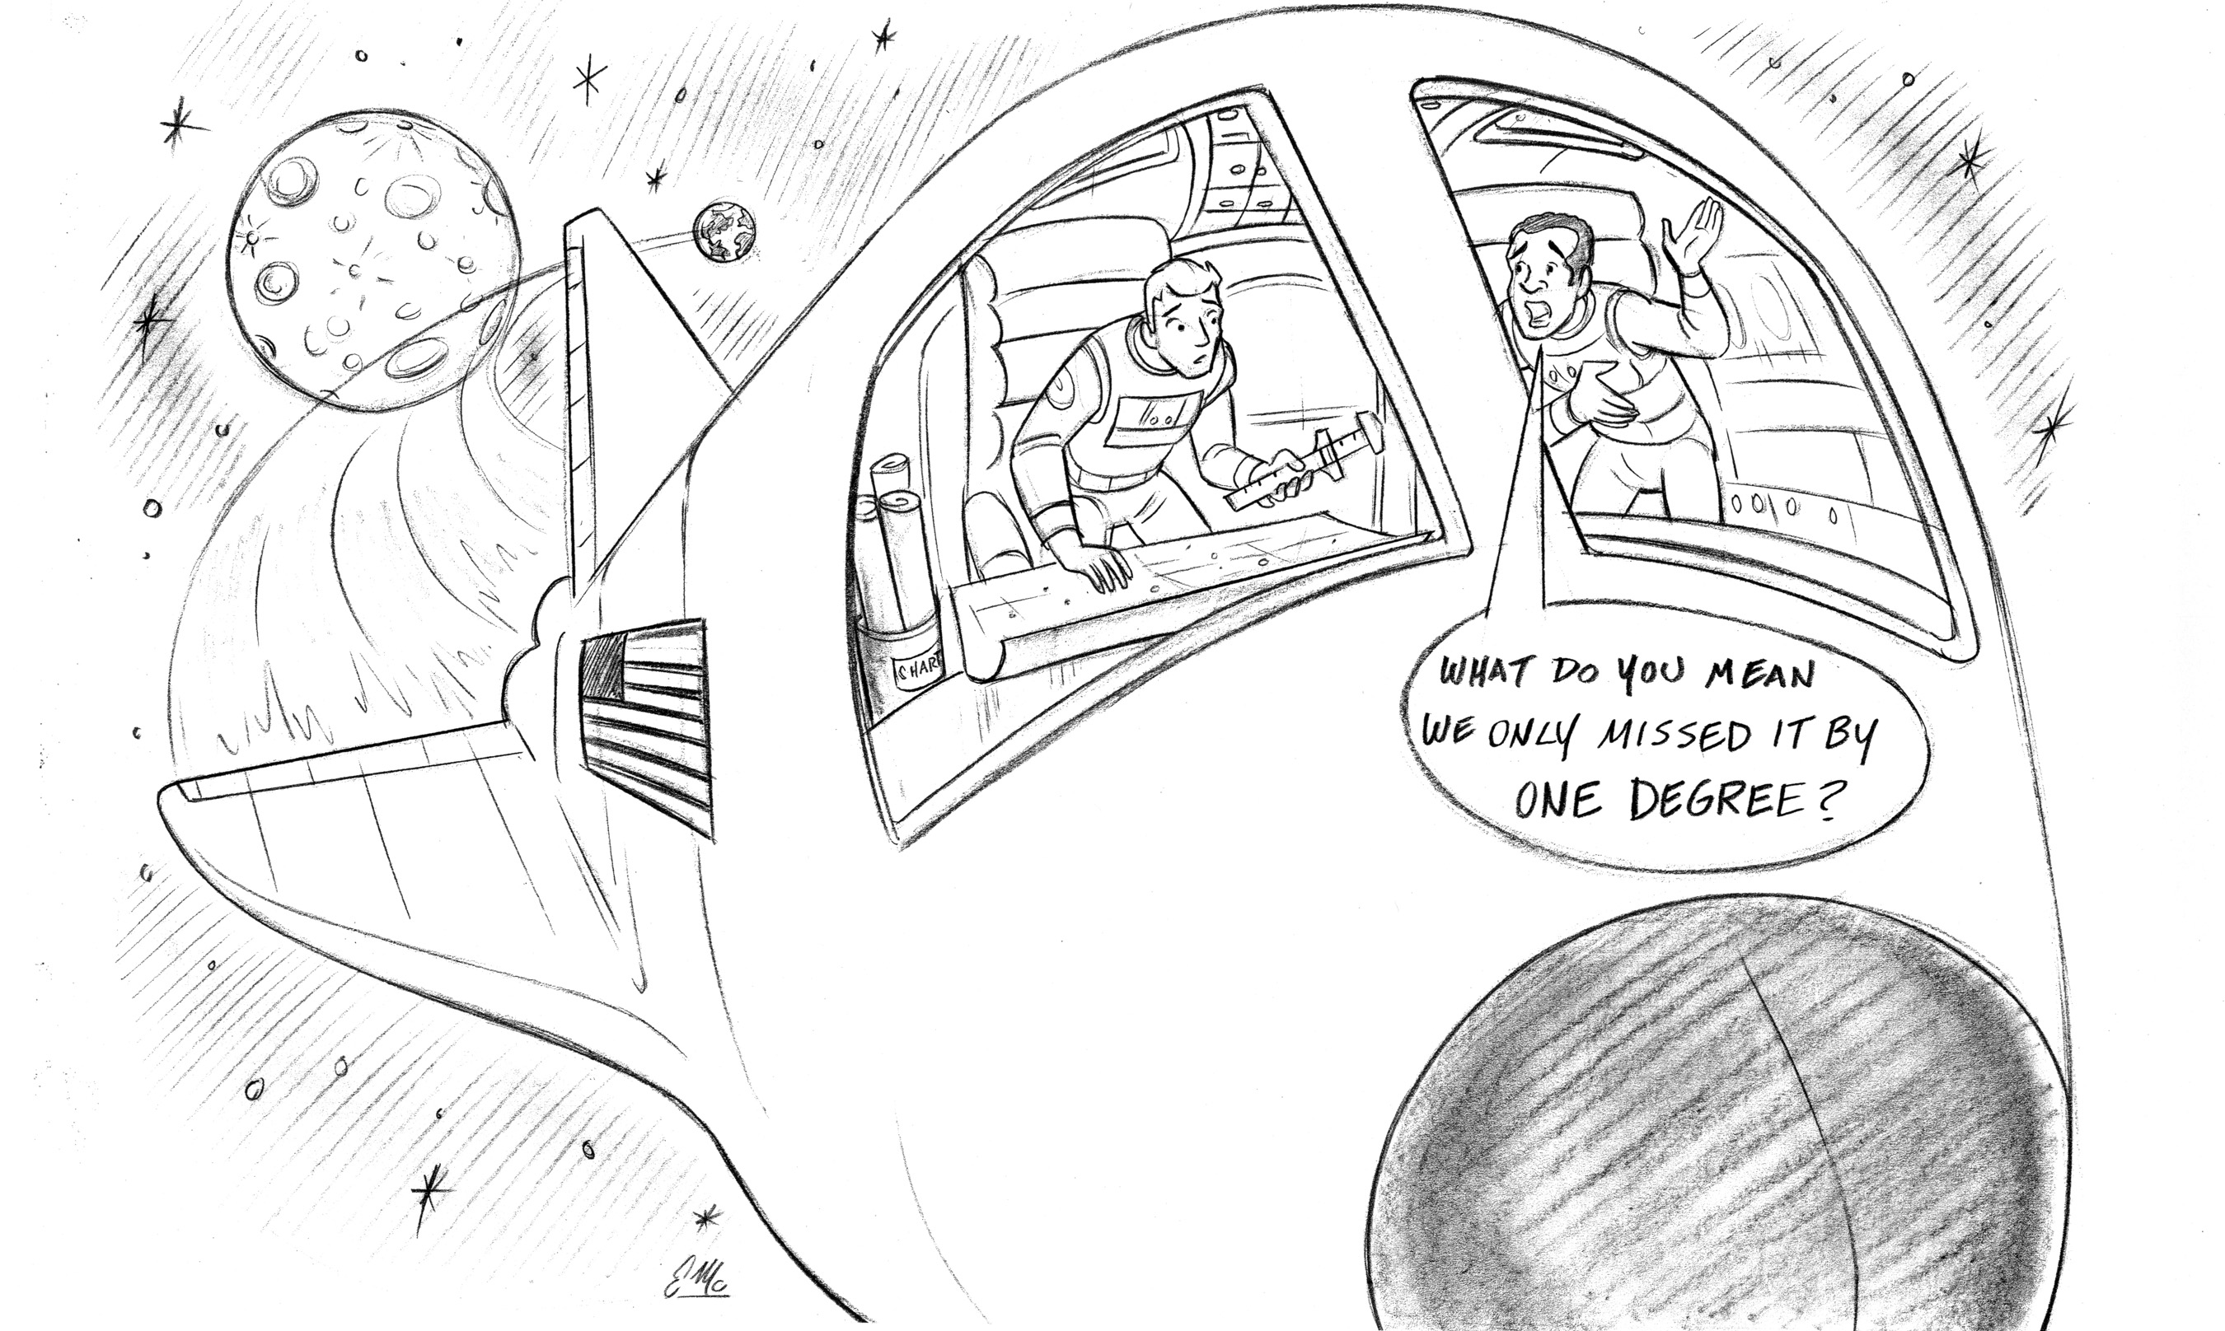
Does Knowing Exactly Who Jesus Is Really Matter?
John 8:24 “That is why I said that you will die in your sins; for unless you believe that I am who I claim to be, you will die in your sins.” (NLT)
#Jesus

Slide 6
Jesus is the Image of God
#Jesus

Slide 7
Jesus Is the Eternal Creator
#Jesus

Slide 8
Jesus Is the Head of the Church
#Jesus

Slide 9
Jesus Is the Reconciler
#Jesus

Slide 10
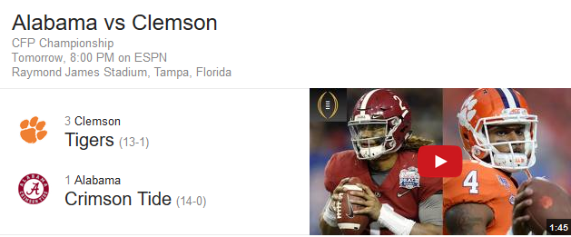
Who is #1?
#Jesus

Slide 11
#Jesus
Following the Life of Jesus

