Slide 1
#Jesus
Following the Life of Jesus

Slide 2
We are prone to wander when we forget what God has done
#Jesus

Slide 3
We are prone to wander when we are afraid or unsure
#Jesus

Slide 4
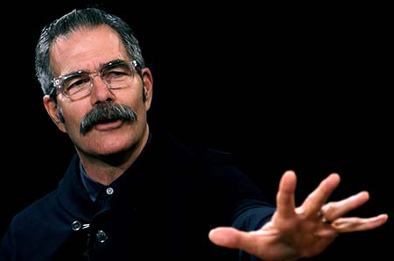
There will be moments when you simply don’t understand what is going on. In fact, you will face moments when what the God who has declared himself to be good brings into your life won’t seem good. It may even seem bad, very bad.
Now, if your faith is based on your ability to fully understand your past, present, and future, then your moments of confusion will become moments of weakening faith. But the reality is that you are not left with only two options—
Paul Tripp in New Morning Mercies

Slide 5
understand everything and rest in peace or understand little and be tormented by anxiety. There is a third way. It really is the way of true biblical faith.
The Bible tells you that real peace is found in resting in the wisdom of the One who holds all of your “what-ifs” and “if-onlys” in his loving hands. Isaiah captures this well with these comforting words: “You keep him in perfect peace whose mind is stayed on you, because he trusts in you” (Isa. 26: 3).
Paul Tripp in New Morning Mercies

Slide 6
In this passage, we see God’s unfolding plan of how to cure our wandering hearts
#Jesus

Slide 7
God’s unfolding plan…
1. God judges people and their sin
#Jesus

Slide 8
God’s unfolding plan…
2. God provides a mediator
#Jesus

Slide 9
God’s unfolding plan…
3. God displays His mercy
#Jesus

Slide 10
#Jesus
Following the Life of Jesus

