Slide 2
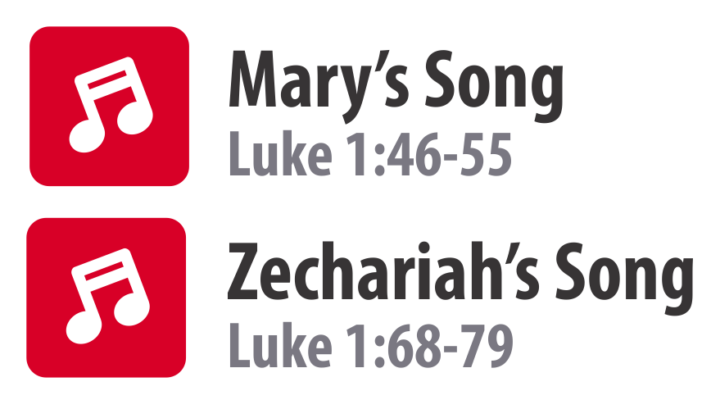
Mary’s praise overflows
from the truth she knows about God

Slide 4
Mary’s praise flows from knowing
who she is in relationship to God
Luke 1:47, 38

Slide 5
Mary’s Praise Comes From What God
is Doing in Her Life and
what He has done in the past
Luke 1:37-38, 49, 54-55

