Slide 1
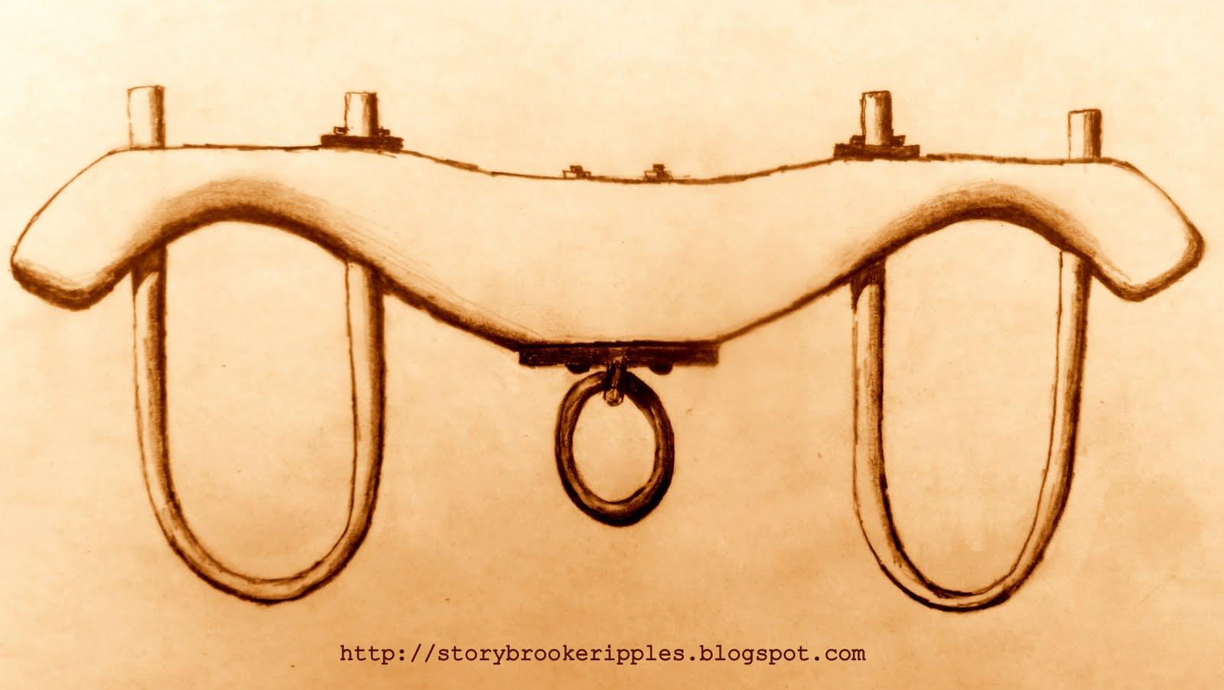
Words for the weary

Slide 2
28 Then Jesus said, “Come to me, all of you who are weary and carry heavy burdens, and I will give you rest. 29 Take my yoke upon you. Let me teach you, because I am humble and gentle at heart, and you will find rest for your souls.
Matthew 11:28-30 NLT

Slide 3
30 For my yoke is easy to bear, and the burden I give you is light.”
Matthew 11:28-30 NLT

Slide 4
* COME
Words for the weary

Slide 5
* TAKE
Words for the weary

Slide 6
* LEARN
Words for the weary

Slide 7
Words for the weary

