Slide 1
1 Samuel
Chapters 9 & 10

Slide 2
Looking for Donkeys
* God is at Work Through Each of Life’s Events

Slide 3
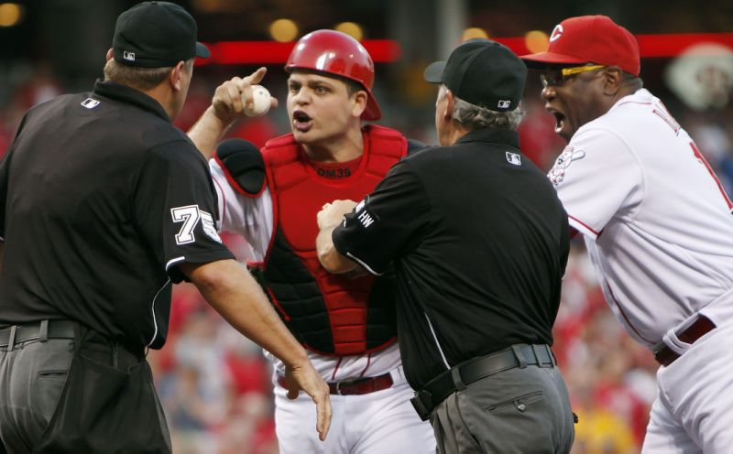
Providence
There’s more going on here
than we can see

Slide 4
Providence
Divine providence is the governance of God by which He, with wisdom and love, cares for and directs all things in the universe.
The doctrine of divine providence asserts that God is in complete control of all things. He is sovereign over the universe as a whole (Psalm 103:19), the physical world (Matthew 5:45), the affairs of nations (Psalm 66:7), human destiny (Galatians 1:15), human successes and failures (Luke 1:52), and the protection of His people (Psalm 4:8).

Slide 5
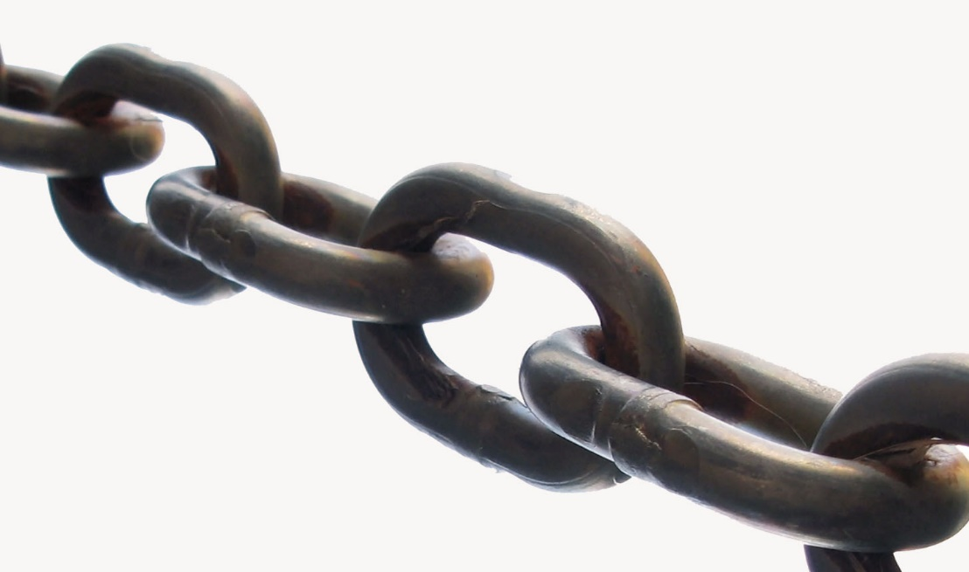
Chain of God’s
Providence
Failed EE Class led to Math Major
Math Major led to Math Masters Degree
Math Masters Degree led to Columbus State teaching to provide for family

Slide 6
Chain of God’s
Providence
Karen Marshall goes to GCC church in Cbus
Karen tells Linda Marshall (at BGSU) and Linda Decides to Transfer to OSU
Karen goes on church plant to BGSU
Linda meets Greg at OSU

Slide 7
Chain of God’s
Providence
#2 team in college football loses yesterday
#3 team in college football loses yesterday
#4 team in college football loses yesterday

Slide 8
Providence
Don’t Be Afraid, but Trust in God
Proverbs 20:24; 16:9

Slide 9
Providence
In Everything Give Thanks
1 Thessalonians 5:18; Romans 8:28

Slide 10
Looking for Donkeys
* God’s Uses “Unlikely” People and Equips them to do His Will

Slide 11
1 Samuel
Chapters 9 & 10

