Slide 1
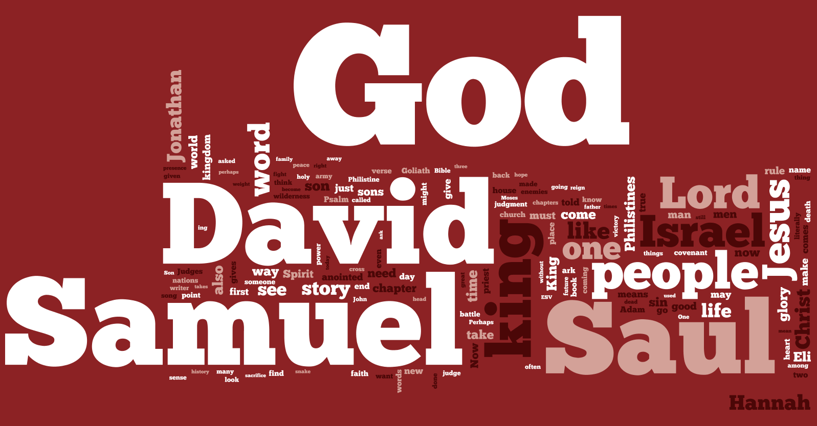
1 Samuel
3:1 - 4:1

Slide 2
Speak Lord…
God’s Silence
1 Samuel 3:1-3
…I’m Listening

Slide 3
Speak Lord…
Why was the
word of the Lord rare?
…I’m Listening

Slide 4
Amos 8:11-12 ESV
11 “Behold, the days are coming,” declares the Lord God, “when I will send a famine on the land—
not a famine of bread, nor a thirst for water, but of hearing the words of the Lord.
12 They shall wander from sea to sea, and from north to east; they shall run to and fro, to seek the word of the Lord, but they shall not find it.”

Slide 5
Speak Lord…
Can God’s Word
Be Rare Now?
…I’m Listening

Slide 6
Speak Lord…
God Speaks
1 Samuel 3:4-14
…I’m Listening

Slide 7
Speak Lord…
God has Spoken to Us
And He Still Speaks
…I’m Listening

Slide 8
Hebrews 1:1-2 ESV
1 Long ago, at many times and in many ways, God spoke to our fathers by the prophets,
2 but in these last days he has spoken to us by his Son, whom he appointed the heir of all things, through whom also he created the world.

Slide 9
2 Peter 1:19-21 ESV
19 And we have the prophetic word more fully confirmed, to which you will do well to pay attention as to a lamp shining in a dark place, until the day dawns and the morning star rises in your hearts, 20 knowing this first of all, that no prophecy of Scripture comes from someone's own interpretation. 21 For no prophecy was ever produced by the will of man, but men spoke from God as they were carried along by the Holy Spirit.

Slide 10
Hebrews 4:12 ESV
For the word of God is living and active, sharper than any two-edged sword, piercing to the division of soul and of spirit, of joints and of marrow, and discerning the thoughts and intentions of the heart.

Slide 11
Speak Lord…
Our Response
1 Samuel 3:15 – 4:1a
…I’m Listening

Slide 12
Speak Lord…
Will I Obey It?
…I’m Listening

Slide 13
Speak Lord…
Will I Speak to Others
What God Has Clearly Spoken?
…I’m Listening

Slide 14
1 Samuel
3:1 - 4:1

