Slide 1
Leading & Being Led
When the Heat is On

Slide 2
1 Peter 5:1-5 ESV
1 So I exhort the elders among you, as a fellow elder and a witness of the sufferings of Christ, as well as a partaker in the glory that is going to be revealed:
2 shepherd the flock of God that is among you, exercising oversight, not under compulsion, but willingly, as God would have you; not for shameful gain, but eagerly;

Slide 3
1 Peter 5:1-5 ESV
3 not domineering over those in your charge, but being examples to the flock.
4 And when the chief Shepherd appears, you will receive the unfading crown of glory.
5 Likewise, you who are younger, be subject to the elders. Clothe yourselves, all of you, with humility toward one another, for “God opposes the proud but gives grace to the humble.”

Slide 4
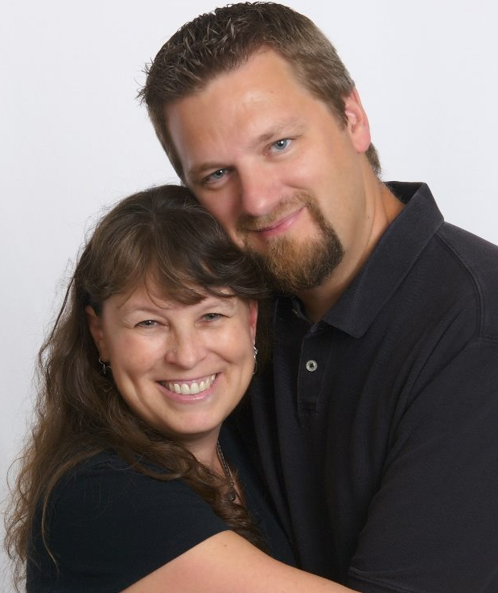
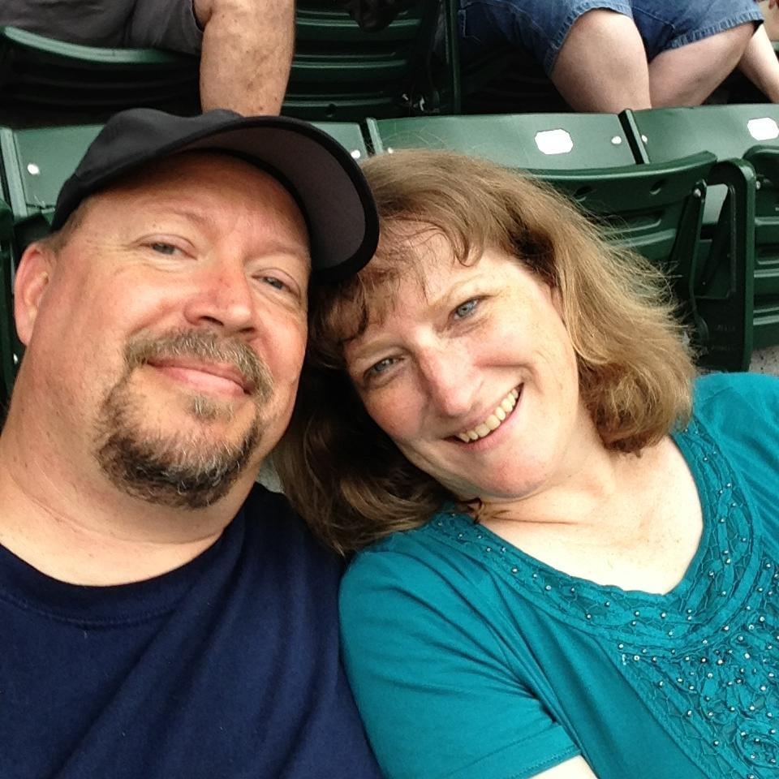
* Those Leading the Church: Elders
1 Peter 5:1
Skip and Johanna Nitz
Doug & Julie
Cornelius
Charley & Linda
Charlton
Greg & Linda
Burlile

Slide 5
Paul and Barnabas appointed elders in all the
churches visited on their 1st missionary journey
Acts 14:23 ESV And when they had appointed elders for them in every church, with prayer and fasting they committed them to the Lord in whom they had believed.

Slide 6
* THE WHAT: The Work Involves Shepherding and Overseeing
1 Peter 5:2

Slide 7
* THE HOW: Willingly, Eagerly, and
by Being an Example
1 Peter 5:2-4

Slide 8
* The “Oil” that Makes this Work: Submission and Humility
1 Peter 5:5

Slide 9
Leading & Being Led
When the Heat is On

