Slide 1
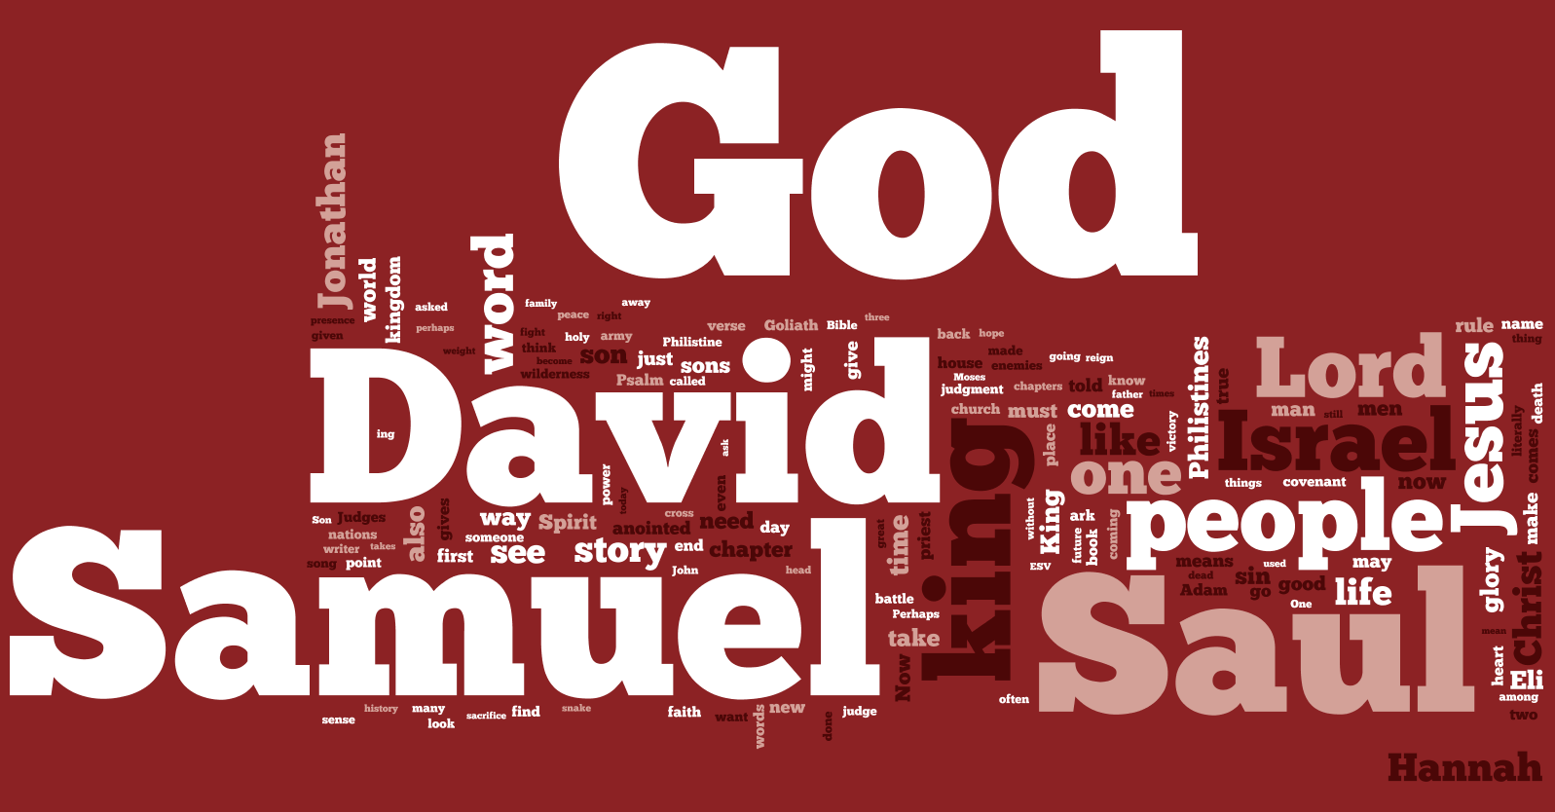
1 Samuel
God is Our King

Slide 2
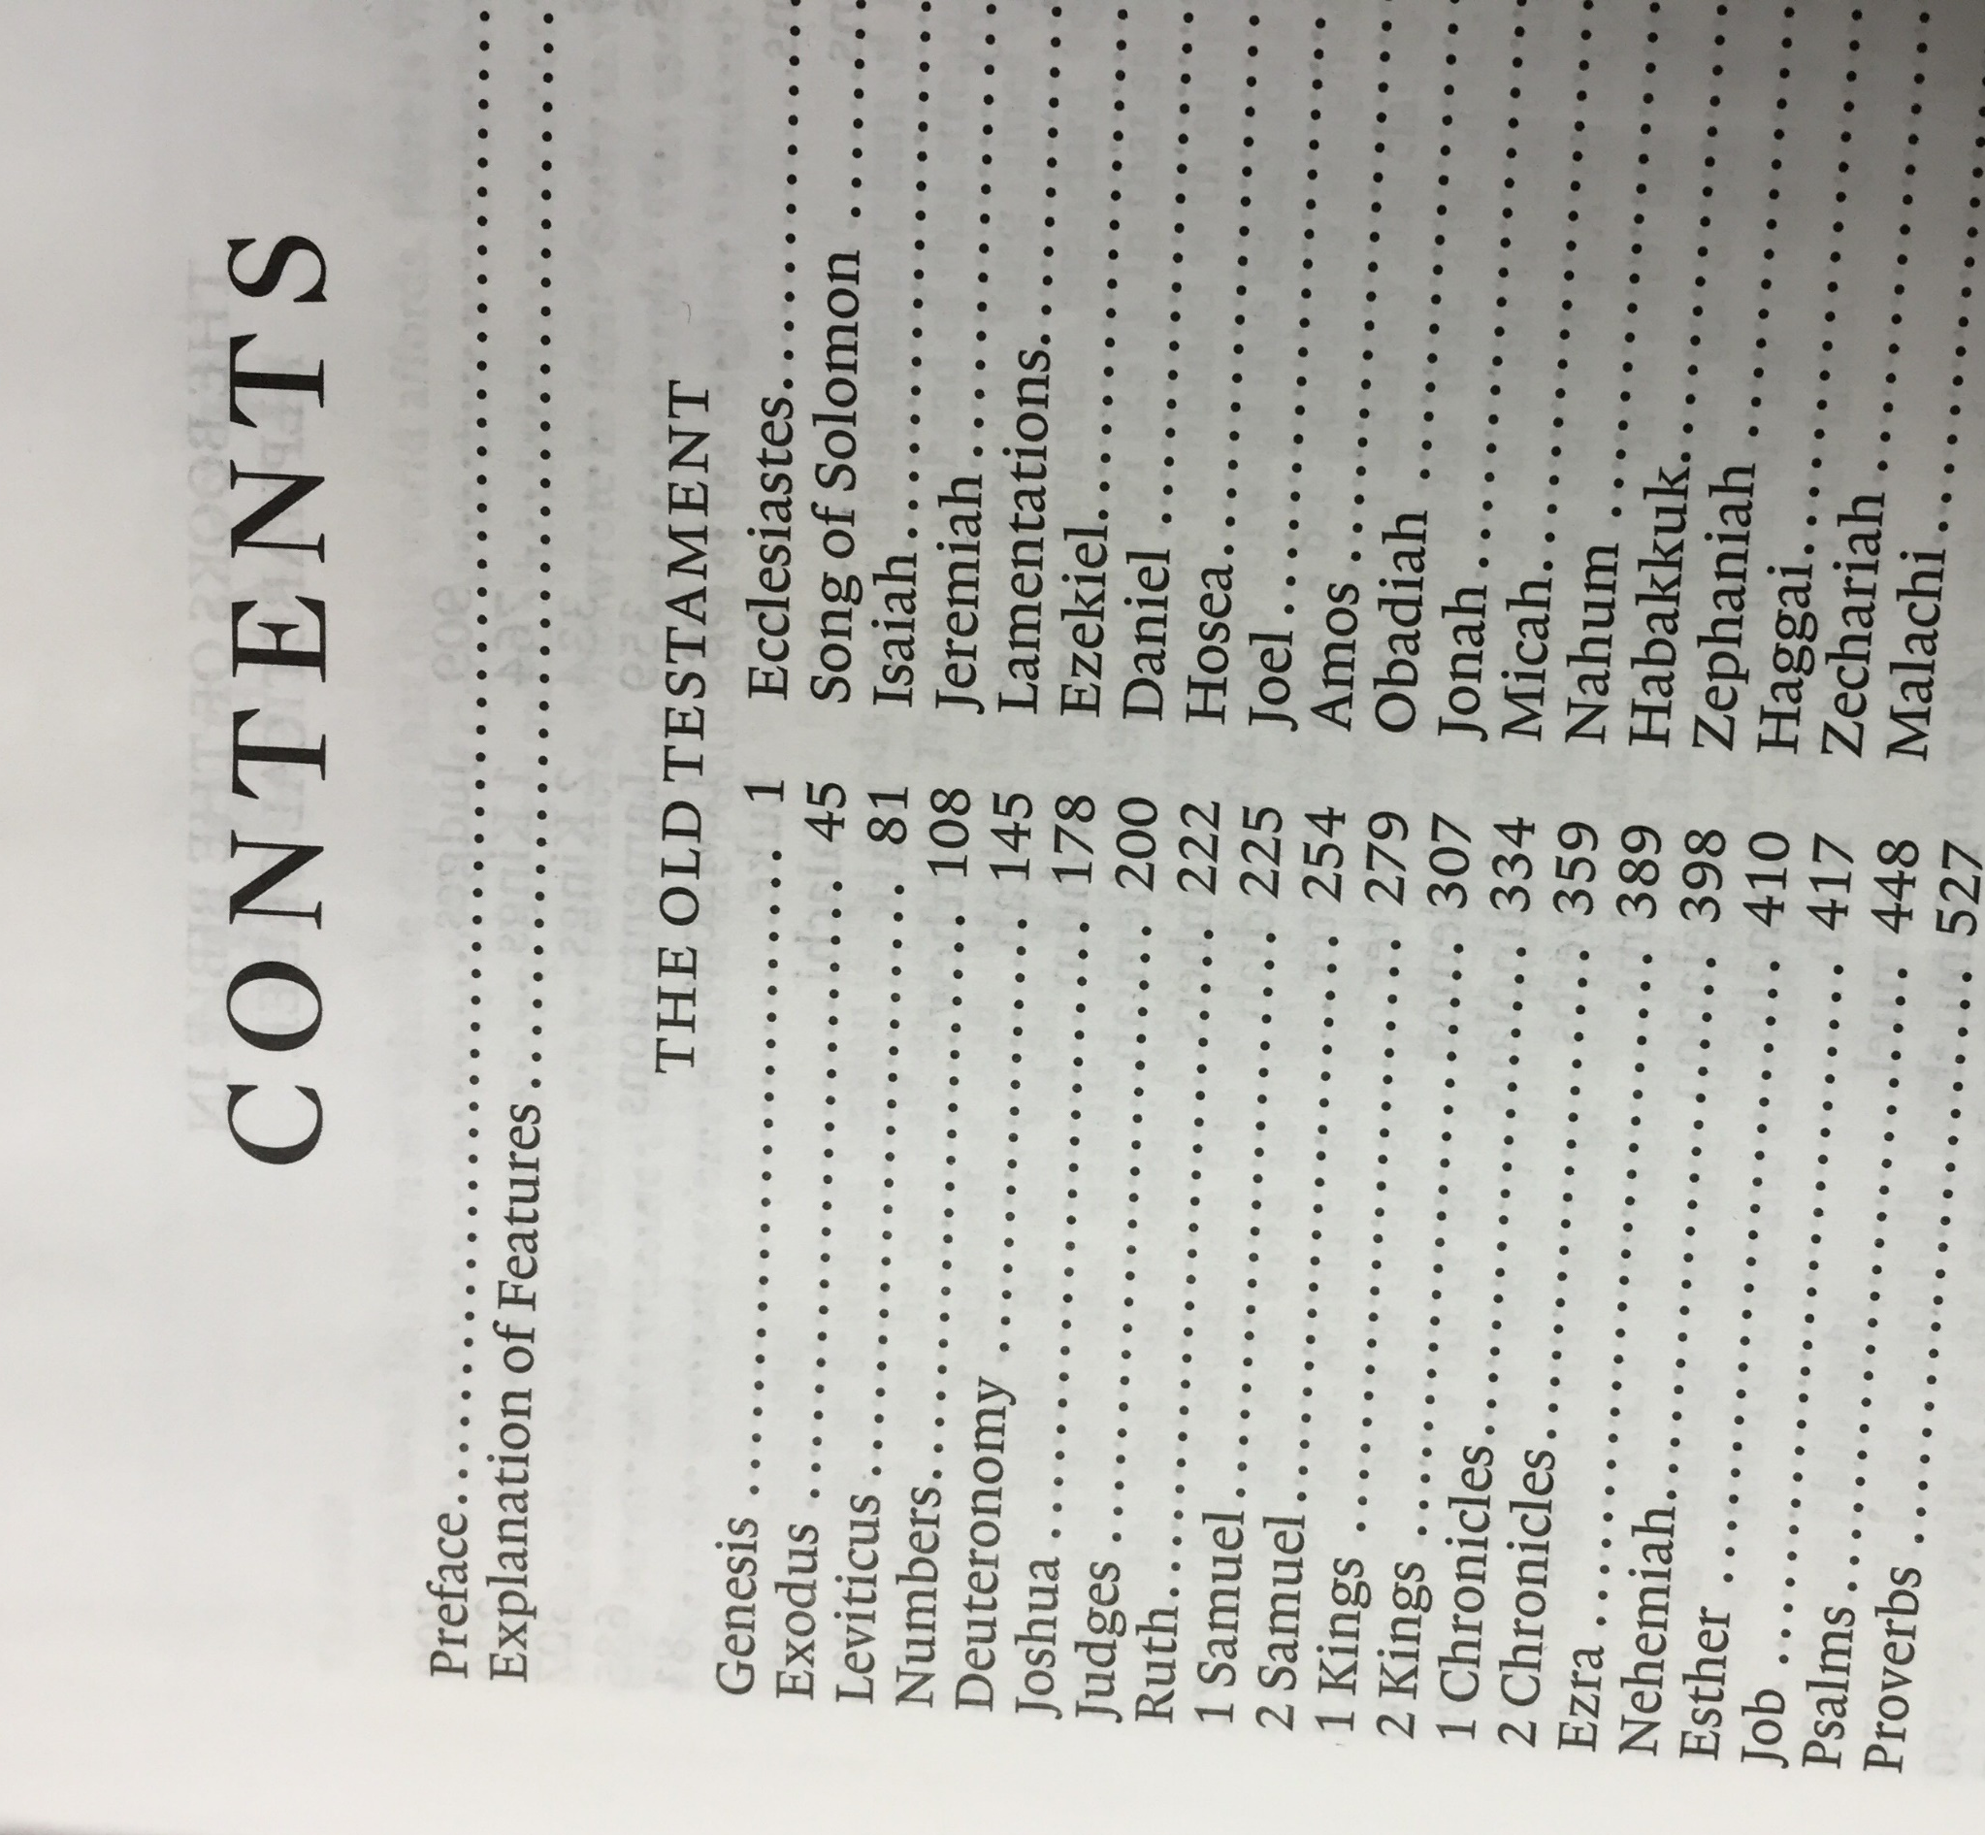
Where is it?

Slide 3
The Context

Slide 4
Judges 21:23-25 ESV
The Context
23 And the people of Benjamin did so and took their wives, according to their number, from the dancers whom they carried off. Then they went and returned to their inheritance and rebuilt the towns and lived in them.
24 And the people of Israel departed from there at that time, every man to his tribe and family, and they went out from there every man to his inheritance.
25 In those days there was no king in Israel. Everyone did what was right in his own eyes.

Slide 5
Prophet, Priest, &
Last Judge of Israel
Samuel
A Man of God’s Word: He Hears, Speaks, & Obeys God’s Word

Slide 6
Saul
The 1st King of Israel
An Impressive, but
Self-Reliant Man

Slide 7
David
The 2nd King of Israel
A Man of Faith Concerned for the
Glory of God

Slide 8
1 Samuel
God is Our King

