Slide 1
Standing Firm in Your Faith

Slide 2
1 Peter 5:6-14 ESV
6 Humble yourselves, therefore, under the mighty hand of God so that at the proper time he may exalt you,
7 casting all your anxieties on him, because he cares for you.
8 Be sober-minded; be watchful. Your adversary the devil prowls around like a roaring lion, seeking someone to devour.

Slide 3
1 Peter 5:6-14 ESV
9 Resist him, firm in your faith, knowing that the same kinds of suffering are being experienced by your brotherhood throughout the world.
10 And after you have suffered a little while, the God of all grace, who has called you to his eternal glory in Christ, will himself restore, confirm, strengthen, and establish you.
11 To him be the dominion forever and ever. Amen.

Slide 4
1 Peter 5:6-14 ESV
12 By Silvanus, a faithful brother as I regard him, I have written briefly to you, exhorting and declaring that this is the true grace of God. Stand firm in it.
13 She who is at Babylon, who is likewise chosen, sends you greetings, and so does Mark, my son.
14 Greet one another with the kiss of love. Peace to all of you who are in Christ.

Slide 5
* Cast Your Cares on God Knowing
He Cares for You
1 Peter 5:6-7

Slide 6
* Know and Resist Your Adversary
1 Peter 5:8-9

Slide 8
Know Your Enemy: The Devil Prowls
Be Aware of His Tactics

Slide 9
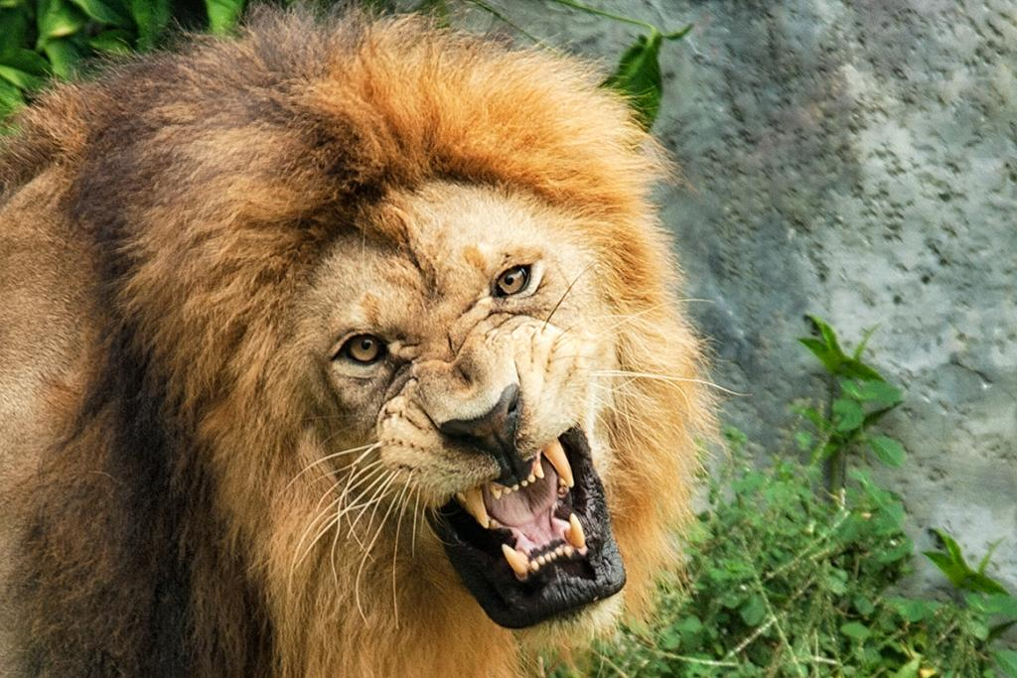
Know Your Enemy: The Devil Roars
Don’t Let Fear Control You

Slide 10
* Know that God has an
Abundance of Enduring and Restoring Grace for You
1 Peter 5:10-11

Slide 11
Standing Firm in Your Faith

