Slide 1
Responding to Suffering

Slide 2
1 Peter 4:12-19 ESV
12 Beloved, do not be surprised at the fiery trial when it comes upon you to test you, as though something strange were happening to you.
13 But rejoice insofar as you share Christ's sufferings, that you may also rejoice and be glad when his glory is revealed.
14 If you are insulted for the name of Christ, you are blessed, because the Spirit of glory and of God rests upon you.

Slide 3
1 Peter 4:12-19 ESV
15 But let none of you suffer as a murderer or a thief or an evildoer or as a meddler.
16 Yet if anyone suffers as a Christian, let him not be ashamed, but let him glorify God in that name.
17 For it is time for judgment to begin at the household of God; and if it begins with us, what will be the outcome for those who do not obey the gospel of God?

Slide 4
1 Peter 4:12-19 ESV
18 And “If the righteous is scarcely saved,
what will become of the ungodly and the sinner?”
19 Therefore let those who suffer according to God's will entrust their souls to a faithful Creator while doing good.

Slide 5
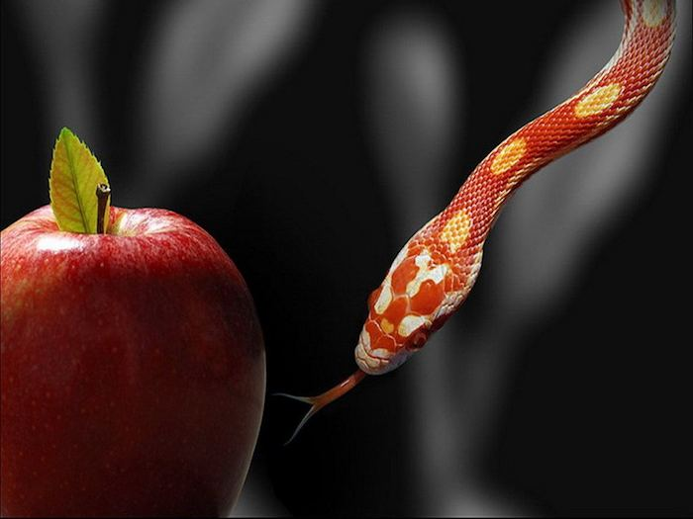
Some of our suffering comes from living in a fallen world

Slide 6
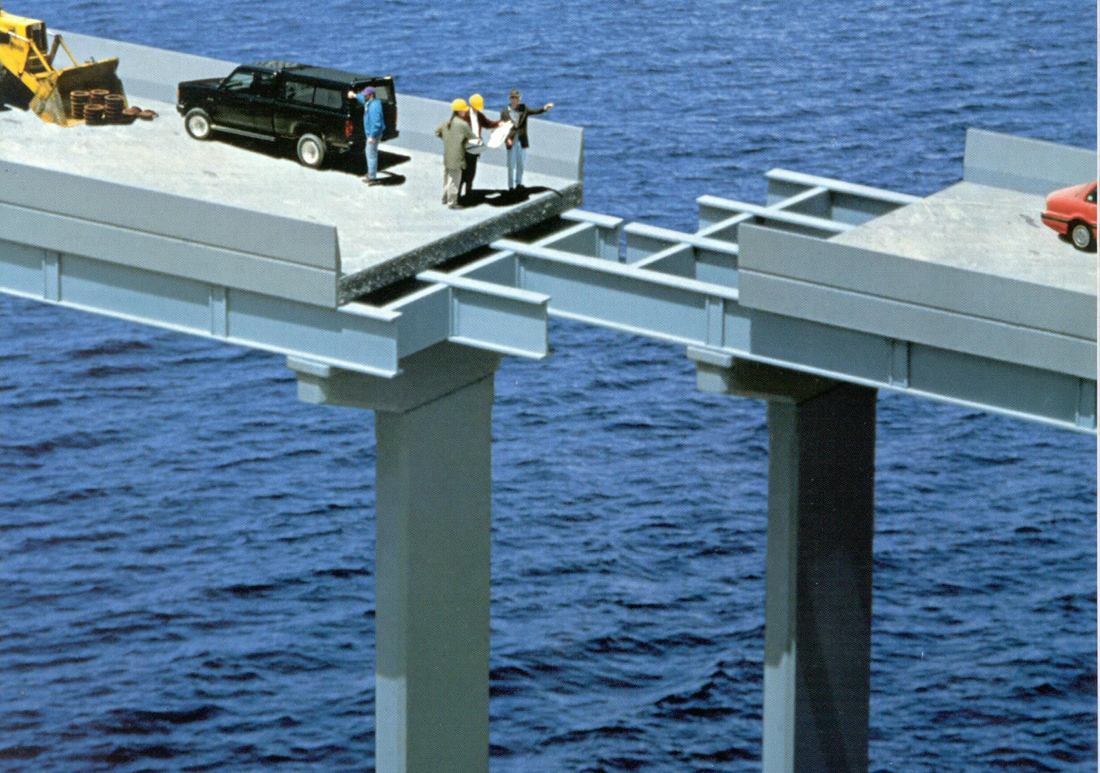
Some of our suffering comes from our own foolish decisions and sinful choices we make or others make

Slide 7
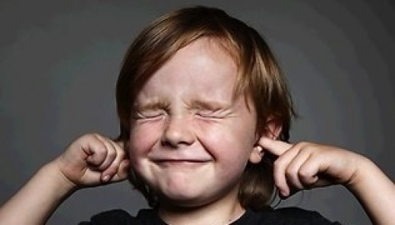
Some of our suffering is God’s loving discipline

Slide 8
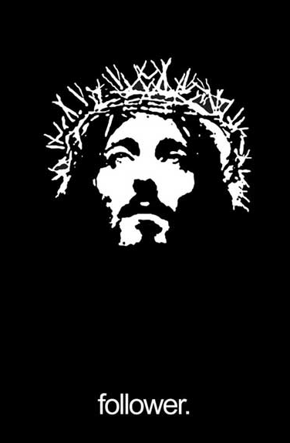
The suffering Peter is talking about is the suffering that comes from being a Christian

Slide 9
Don’t Be Surprised When You Experience Suffering for Being a Christian
1 Peter 4:12

Slide 10
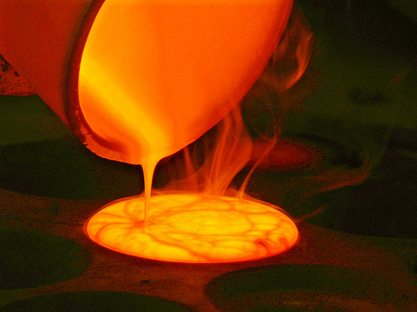
The Purpose of These Fiery Trials (suffering) is to Test and Refine Us
1 Peter 4:12, 17-18

Slide 11
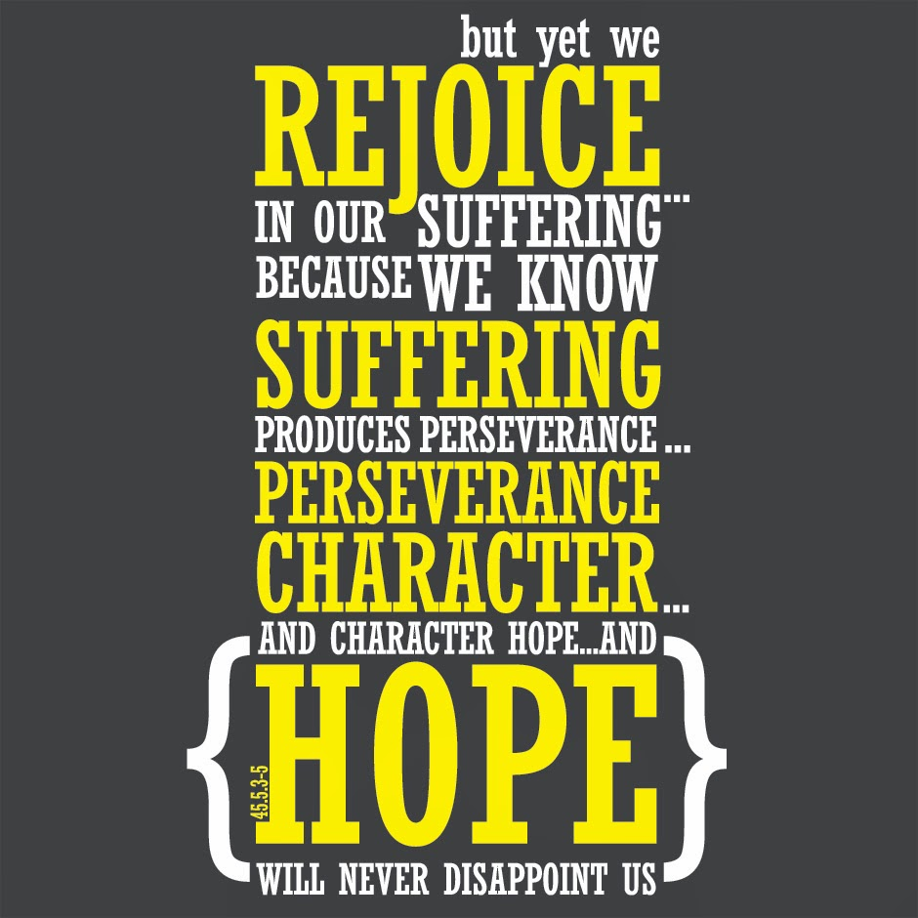
Rather than being Surprised by the Suffering, We Should Rejoice Instead
1 Peter 4:13-14

Slide 12
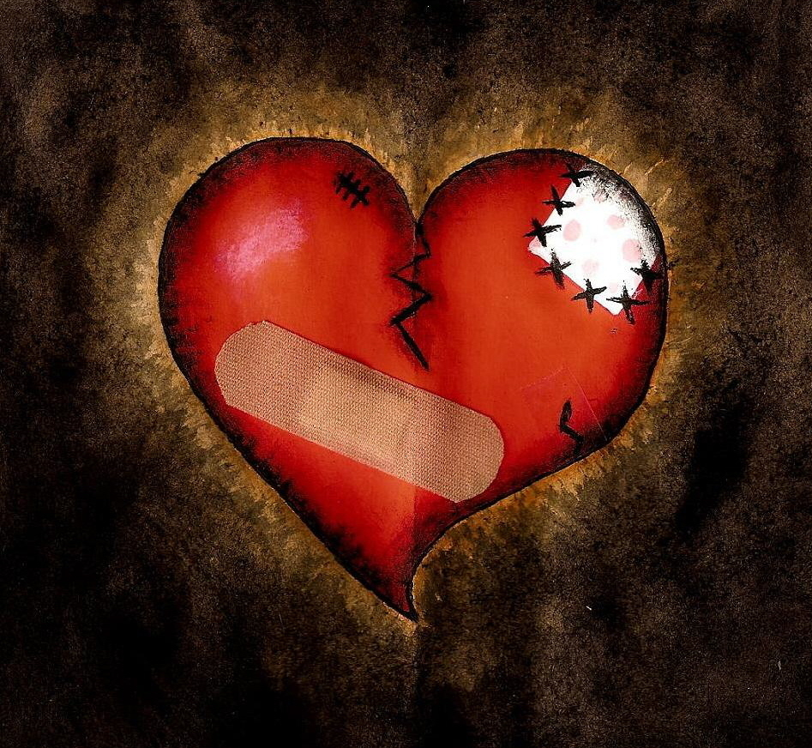
Keep Your Suffering Pure
1 Peter 4:15-16

Slide 13
Rest in God’s Sovereign Control as You Continue to Live for Jesus in the Midst of the Suffering
1 Peter 4:19

Slide 14
Responding to Suffering

