Slide 1
How Should We Live?

Slide 2
1 Peter 4:1-11 HCSB
1 Therefore, since Christ suffered in the flesh, equip yourselves also with the same resolve—because the one who suffered in the flesh has finished with sin—
2 in order to live the remaining time in the flesh, no longer for human desires, but for God’s will.
3 For there has already been enough time spent in doing what the pagans choose to do: carrying on in unrestrained behavior, evil desires, drunkenness, orgies, carousing, and lawless idolatry.

Slide 3
1 Peter 4:1-11 HCSB
4 So they are surprised that you don’t plunge with them into the same flood of wild living—and they slander you.
5 They will give an account to the One who stands ready to judge the living and the dead.
6 For this reason the gospel was also preached to those who are now dead, so that, although they might be judged by men in the fleshly realm, they might live by God in the spiritual realm.

Slide 4
1 Peter 4:1-11 HCSB
7 Now the end of all things is near; therefore, be serious and disciplined for prayer.
8 Above all, maintain an intense love for each other, since love covers a multitude of sins.
9 Be hospitable to one another without complaining.
10 Based on the gift each one has received, use it to serve others, as good managers of the varied grace of God.

Slide 5
1 Peter 4:1-11 HCSB
11 If anyone speaks, it should be as one who speaks God’s words; if anyone serves, it should be from the strength God provides, so that God may be glorified through Jesus Christ in everything. To Him belong the glory and the power forever and ever. Amen.

Slide 6
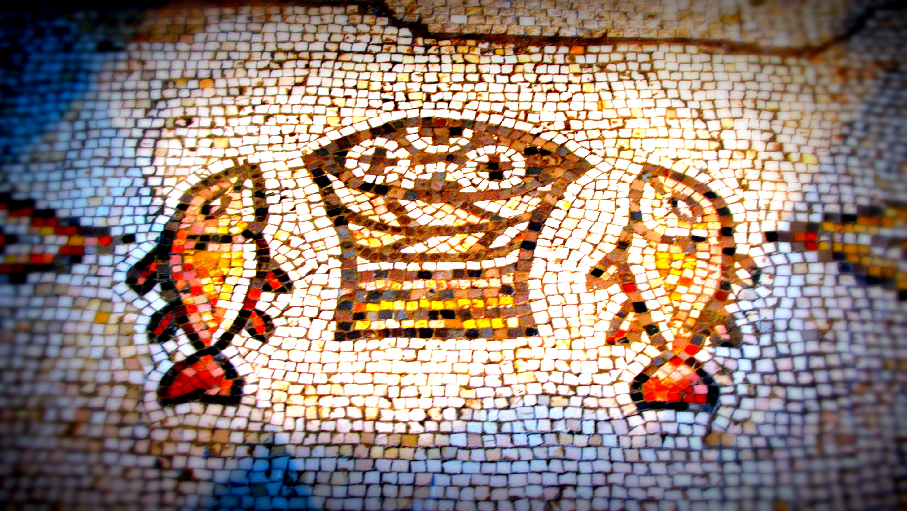
*Live to do God’s Will

Slide 7
*Live in Light of Christ’s Return and
the Coming Judgement

Slide 8
How Should We Live?

