Slide 1
Corporate Worship & Your Heart

Slide 2
*It’s Not Primarily What We Bring to God, It’s About What He Wants to Do in Us

Slide 3
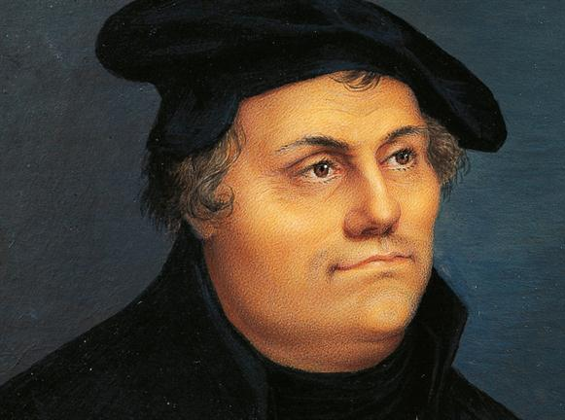
“At home, in my own house, there is no warmth or vigor in me, but in the church when the multitude is gathered together, a fire is kindled in my heart and it breaks its way through.”-- Martin Luther

Slide 4
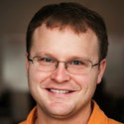
“There are times — may God make them many — when the Holy Spirit takes the Scripture read, the prayer spoken, the chorus sung, or the truth preached and presses it right to the point of our need, and not merely informs our Christian walk, but heals us in that moment.” -- David Mathis

Slide 5
Corporate Worship & Your Heart

