Slide 2
Our Calling to Bless

Slide 3
1 Peter 3:8-12 NLT
8 Finally, all of you should be of one mind. Sympathize with each other. Love each other as brothers and sisters. Be tenderhearted, and keep a humble attitude.
9 Don’t repay evil for evil. Don’t retaliate with insults when people insult you.
Instead, pay them back with a blessing.
That is what God has called you to do,
and he will grant you his blessing.

Slide 4
1 Peter 3:8-12 NLT
10 For the Scriptures say,
“If you want to enjoy life
and see many happy days,
keep your tongue from speaking evil
and your lips from telling lies.

Slide 5
1 Peter 3:8-12 NLT
11 Turn away from evil and do good.
Search for peace, and work to maintain it.
12 The eyes of the Lord watch over those who do right,
and his ears are open to their prayers.
But the Lord turns his face
against those who do evil.”

Slide 6
*The Big Picture of the Passage

Slide 7
1 Peter 3:8-12 NLT
8 Finally, all of you should be of one mind. Sympathize with each other. Love each other as brothers and sisters. Be tenderhearted, and keep a humble attitude.
9 Don’t repay evil for evil. Don’t retaliate with insults when people insult you.
Instead, pay them back with a blessing.
That is what God has called you to do,
and he will grant you his blessing.

Slide 8
*Heart Attitudes that Enable Us
to Fulfill This Calling

Slide 9
1 Peter 3:8 NLT
8 Finally, all of you should be of one mind.
Sympathize with each other.
Love each other as brothers and sisters.
Be tenderhearted,
and keep a humble attitude.

Slide 10
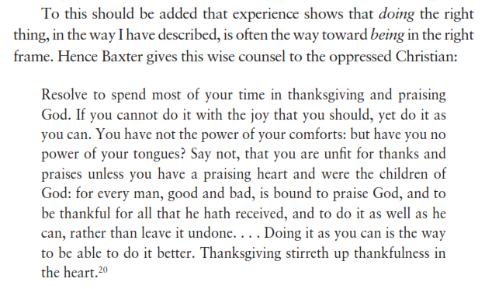
Richard Baxter as quoted in
“When I Don’t Desire God”

Slide 11
*Look for Ways to be a Blessing

Slide 12
1 Peter 3:9 NLT
9 Don’t repay evil for evil. Don’t retaliate with insults when people insult you.
Instead, pay them back with a blessing.
That is what God has called you to do,
and he will grant you his blessing.

Slide 13
*The Life God Blesses

Slide 14
1 Peter 3:10-12 NLT (quotation of Psalm 34:12-16)
10 For the Scriptures say,
“If you want to enjoy life
and see many happy days,
keep your tongue from speaking evil
and your lips from telling lies.
11 Turn away from evil and do good.
Search for peace, and work to maintain it.
12 The eyes of the Lord watch over those who do right,
and his ears are open to their prayers.
But the Lord turns his face
against those who do evil.”

Slide 15
Our Calling to Bless

