Slide 1
Don’t Follow Your Heart

Slide 2
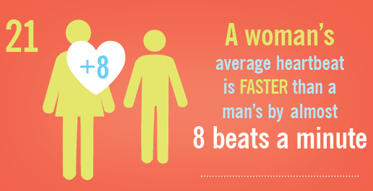
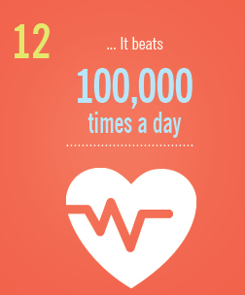
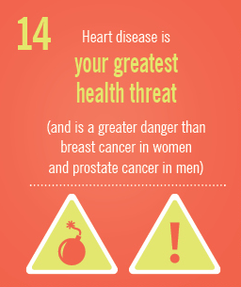
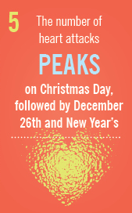
The Human Heart
https://health.clevelandclinic.org/2015/07/21-amazing-facts-about-your-heart-infographic/

Slide 3
Don’t Follow Your Heart

Slide 4
The Heart =
The term heart generally speaks of the inner person and the spiritual life in all its various aspects. Like the human physical heart, it is central and vital to our existence.

Slide 5
*God Cares About What is Going on in Our Heart
1 Samuel 16:6-7

Slide 6
*Our Actions, Words, and Thoughts Originate in Our Heart
Matthew 15:18-19

Slide 7
*Each One of Us Has a Heart Problem
Jeremiah 17:9

Slide 8
*We All Need a New Heart and Only God Can Do That
Ezekiel 36:24-28

Slide 9
*We Should Not Follow Our Heart, We Must Let God Lead Our Heart
Romans 7:21-25

Slide 10
*We Allow God to Lead Our Heart by Trusting in the Lord and Not Our Own Understanding
Proverbs 3:5-6

Slide 11
Don’t Follow Your Heart

