Slide 1
Encouragement to Stand

Slide 2
1 Peter 3:18-22 NLT
18 Christ suffered for our sins once for all time. He never sinned, but he died for sinners to bring you safely home to God. He suffered physical death, but he was raised to life in the Spirit.
19 So he went and preached to the spirits in prison—
20 those who disobeyed God long ago when God waited patiently while Noah was building his boat. Only eight people were saved from drowning in that terrible flood.

Slide 3
1 Peter 3:18-22 NLT
21 And that water is a picture of baptism, which now saves you, not by removing dirt from your body, but as a response to God from a clean conscience. It is effective because of the resurrection of Jesus Christ.
22 Now Christ has gone to heaven. He is seated in the place of honor next to God, and all the angels and authorities and powers accept his authority.

Slide 4
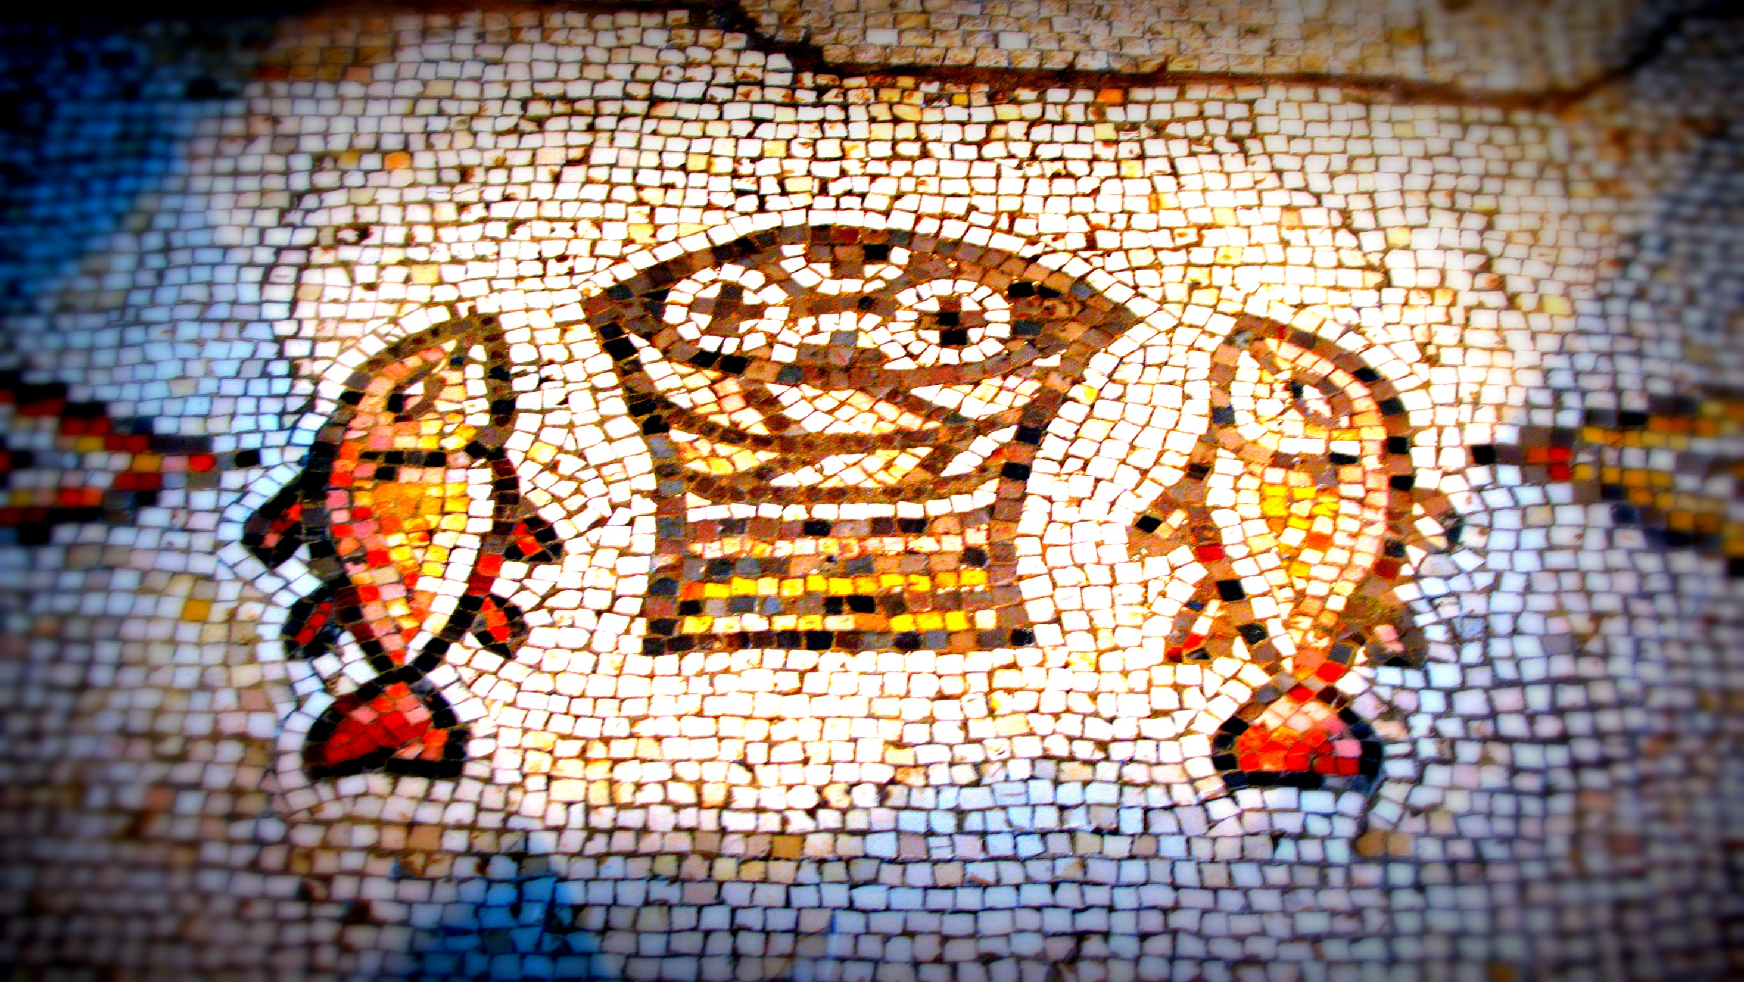
*Jesus Suffered and was Vindicated

Slide 5
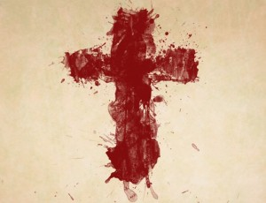
“Jesus Suffered also”
The Gospel
Jesus took our punishment for sin
Jesus’ suffering was enough
The result of Jesus’ death and resurrection is we are brought near to God if we believe

Slide 6
*Noah Suffered and was Vindicated

Slide 7
Noah’s Situation was not that Different from Ours
https://answersingenesis.org/noahs-ark/
Noah was in the minority in a hostile culture
Noah continued to trust God even though he had not seen a flood
Noah was a bold witness to those around him
In the time of Noah, God was patiently waiting for people to turn to Him

Slide 8
Encouragement to Stand

