Slide 1
Living Fearlessly in Suffering

Slide 2
1 Peter 3:13-18 ESV
13 Now who is there to harm you if you are zealous for what is good?
14 But even if you should suffer for righteousness' sake, you will be blessed. Have no fear of them, nor be troubled,
15 but in your hearts honor Christ the Lord as holy, always being prepared to make a defense to anyone who asks you for a reason for the hope that is in you; yet do it with gentleness and respect,

Slide 3
1 Peter 3:13-18 ESV
16 having a good conscience, so that, when you are slandered, those who revile your good behavior in Christ may be put to shame.
17 For it is better to suffer for doing good, if that should be God's will, than for doing evil.
18 For Christ also suffered once for sins, the righteous for the unrighteous, that he might bring us to God, being put to death in the flesh but made alive in the spirit,

Slide 4
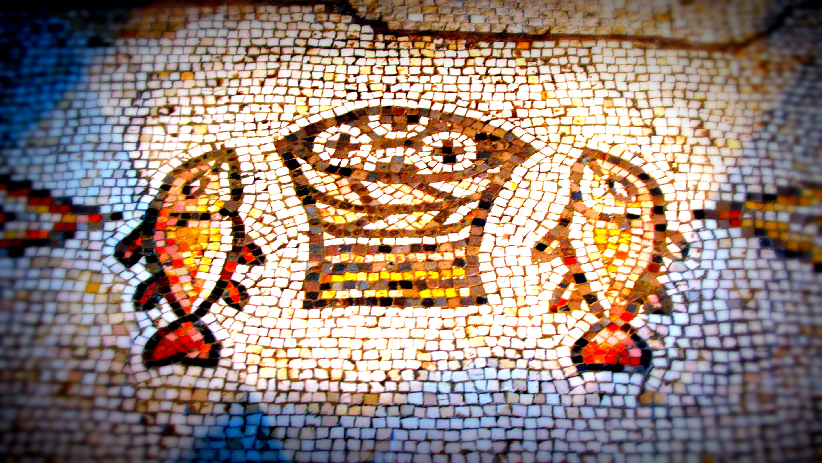
*Suffering is NOT the Opposite of Blessing

Slide 5
*No One Can Ultimately Harm You
Unless God Allows it

Slide 6
*Suffering is Not Something to Just Endure,
but it is an Opportunity to Witness

Slide 7
*A Bold Witness Must be Backed Up
By a Consistent Life Style

Slide 8
*Remember: Jesus Suffered Too

Slide 9
*Remember: Our Worst Enemy,
Sin, Has Been Defeated

Slide 10
Living Fearlessly in Suffering

