Slide 1
#WorldsToughestJob

Slide 2
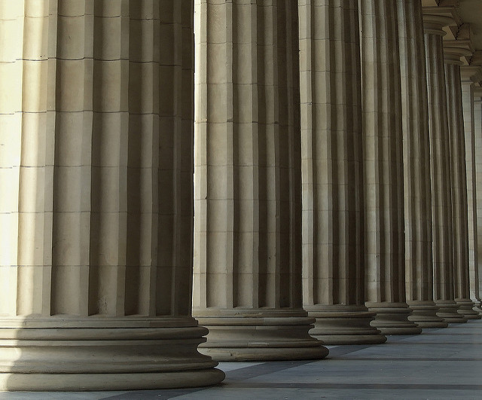
Core Beliefs:
The Grace of God

Slide 3
2 Timothy 2:1 ESV
You then, my child, be strengthened by the grace that is in Christ Jesus

Slide 4
2 Peter 3:18 ESV
But grow in the grace and knowledge of our Lord and Savior Jesus Christ. To him be the glory both now and to the day of eternity. Amen.

Slide 5
*God is a Gracious God

Slide 6
Psalm 103:8 ESV
The Lord is merciful and gracious, slow to anger and abounding in steadfast love.

Slide 7
Isaiah 30:18 ESV
Therefore the Lord waits to be gracious to you,
and therefore he exalts himself to show mercy to you.
For the Lord is a God of justice;
blessed are all those who wait for him.

Slide 8
*Grace is God’s Love in Action

Slide 9
Romans 5:6-9 ESV
6 For while we were still weak, at the right time Christ died for the ungodly.
7 For one will scarcely die for a righteous person—though perhaps for a good person one would dare even to die—
8 but God shows his love for us in that while we were still sinners, Christ died for us.
9 Since, therefore, we have now been justified by his blood, much more shall we be saved by him from the wrath of God.

Slide 10
2 Corinthians 12:9-10 ESV
9 But he said to me, “My grace is sufficient for you, for my power is made perfect in weakness.” Therefore I will boast all the more gladly of my weaknesses, so that the power of Christ may rest upon me.
10 For the sake of Christ, then, I am content with weaknesses, insults, hardships, persecutions, and calamities. For when I am weak, then I am strong.

Slide 11
2 Corinthians 9:8 ESV
And God is able to make all grace abound to you, so that having all sufficiency in all things at all times, you may abound in every good work.

Slide 12
Hebrews 4:16 ESV
Let us then with confidence draw near to the throne of grace, that we may receive mercy and find grace to help in time of need.

Slide 13
*Salvation is by Grace through Faith
and so is the Christian Life

Slide 14
Romans 5:1-2 ESV
1 Therefore, since we have been justified by faith, we have peace with God through our Lord Jesus Christ.
2 Through him we have also obtained access by faith into this grace in which we stand, and we rejoice in hope of the glory of God.

Slide 15
Colossians 2:6-7 ESV
6 Therefore, as you received Christ Jesus the Lord, so walk in him,
7 rooted and built up in him and established in the faith, just as you were taught, abounding in thanksgiving.

Slide 16
* There are Means of Grace by which We Can Position Ourselves to be Receivers of God’s Grace

Slide 17
http://www.desiringgod.org/books/habits-of-grace

Slide 18
“God’s regular channels of grace are His word, His ear, and His people. So often, he showers his people with unexpected favor. But typically the grace that sends our roots deepest, truly grows us up in Christ, and produces lasting spiritual maturity, streams from the ordinary and unspectacular paths of fellowship, prayer, and Bible intake in its many forms.” -- David Mathis

Slide 19
*Pride Can Affect our Christian Walk and the Grace and Power We Receive to Live it.

Slide 20
1 Peter 5:5-6 ESV
5 Likewise, you who are younger, be subject to the elders. Clothe yourselves, all of you, with humility toward one another, for “God opposes the proud but gives grace to the humble.”
6 Humble yourselves, therefore, under the mighty hand of God so that at the proper time he may exalt you,

Slide 21
Core Beliefs:
The Grace of God

