Slide 1
Avoiding Identity Amnesia

Slide 2
1 Peter 2:4-10 ESV
4 As you come to him, a living stone rejected by men but in the sight of God chosen and precious,
5 you yourselves like living stones are being built up as a spiritual house, to be a holy priesthood, to offer spiritual sacrifices acceptable to God through Jesus Christ.
6 For it stands in Scripture:
“Behold, I am laying in Zion a stone,
a cornerstone chosen and precious,
and whoever believes in him will not be put to shame.”

Slide 3
1 Peter 2:4-10 ESV
7 So the honor is for you who believe, but for those who do not believe,
“The stone that the builders rejected
has become the cornerstone,”
8 and A stone of stumbling, and a rock of offense.”
They stumble because they disobey the word, as they were destined to do.

Slide 4
1 Peter 2:4-10 ESV
9 But you are a chosen race, a royal priesthood, a holy nation, a people for his own possession, that you may proclaim the excellencies of him who called you out of darkness into his marvelous light.
10 Once you were not a people, but now you are God's people; once you had not received mercy, but now you have received mercy.

Slide 5
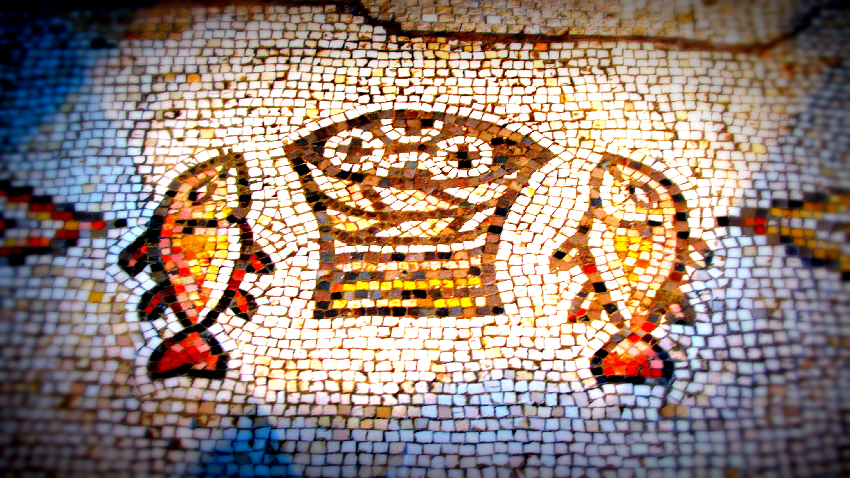
Jesus is the Chosen and Precious Living Stone
1 Peter 2:4-5

Slide 6
Jesus is the Foundation Stone (Cornerstone)
1 Peter 2:6-7

Slide 7
Jesus is the Stumbling Stone
1 Peter 2:7-8

Slide 8
We Must Not Forget Our Identity is
Tied to a Community
1 Peter 2:9-10

Slide 9
We Must Not Forget Our Identity
Determines What We Do
1 Peter 2:9-10

Slide 10
Avoiding Identity Amnesia

