Slide 1
A Christian’s Hope

Slide 2
1 Peter 1:3-7 ESV
3 Praise be to the God and Father of our Lord Jesus Christ! In his great mercy he has given us new birth into a living hope through the resurrection of Jesus Christ from the dead,
4 and into an inheritance that can never perish, spoil or fade. This inheritance is kept in heaven for you,
5 who through faith are shielded by God’s power until the coming of the salvation that is ready to be revealed in the last time.

Slide 3
1 Peter 1:3-7 ESV
6 In all this you greatly rejoice, though now for a little while you may have had to suffer grief in all kinds of trials.
7 These have come so that the proven genuineness of your faith—of greater worth than gold, which perishes even though refined by fire—may result in praise, glory and honor when Jesus Christ is revealed.

Slide 4
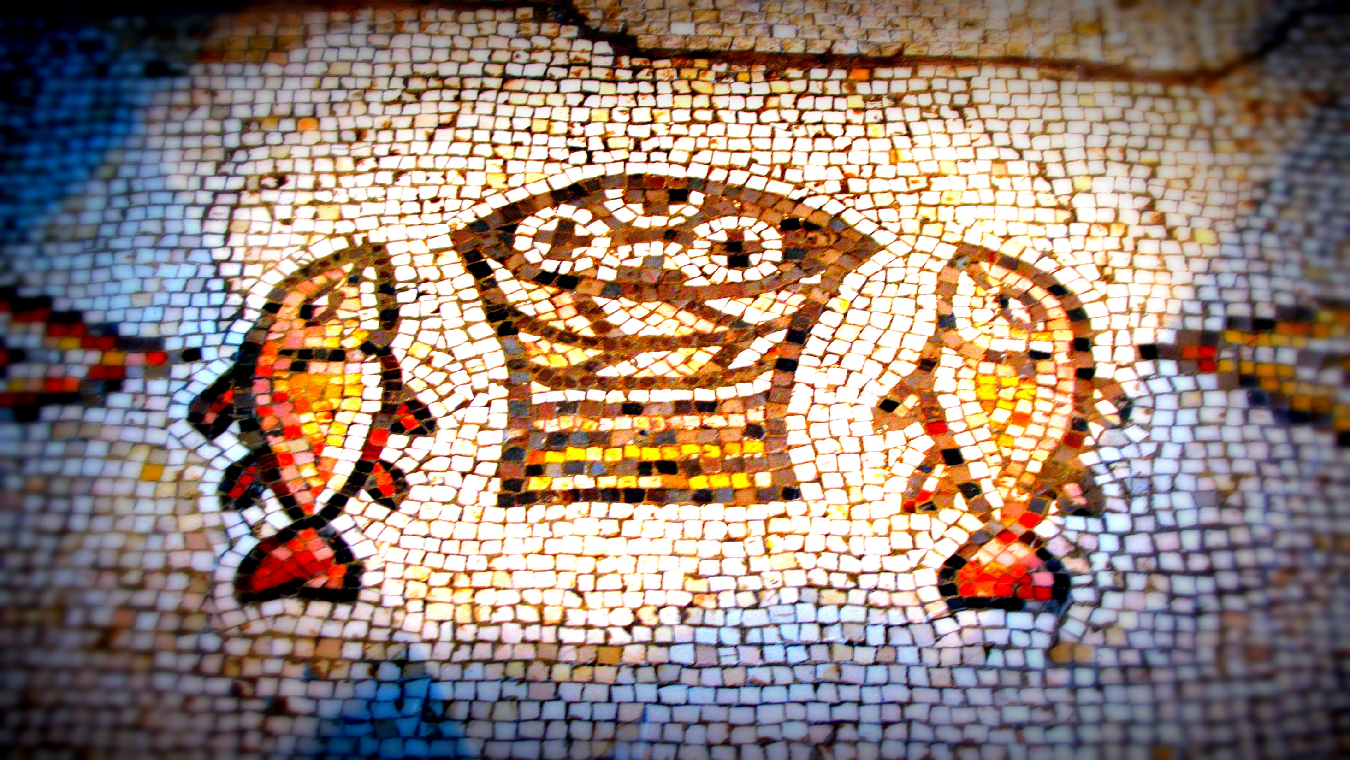
God Has Given Us New Life
1 Peter 1:3

Slide 5
This Living Hope is the Hope of an Inheritance
1 Peter 1:4-5

Slide 6
Joy and Grief Are Mixed Together as We
Embrace the Trials of this Life
1 Peter 1:6-7

Slide 7
A Christian’s Hope

