Slide 1
Setting Our Hope

Slide 2
1 Peter 1:13-21 ESV
13 Therefore, preparing your minds for action, and being sober-minded, set your hope fully on the grace that will be brought to you at the revelation of Jesus Christ.
14 As obedient children, do not be conformed to the passions of your former ignorance,
15 but as he who called you is holy, you also be holy in all your conduct,
16 since it is written, “You shall be holy, for I am holy.”

Slide 3
1 Peter 1:13-21 ESV
17 And if you call on him as Father who judges impartially according to each one's deeds, conduct yourselves with fear throughout the time of your exile,
18 knowing that you were ransomed from the futile ways inherited from your forefathers, not with perishable things such as silver or gold,
19 but with the precious blood of Christ, like that of a lamb without blemish or spot.

Slide 4
1 Peter 1:13-21 ESV
20 He was foreknown before the foundation of the world but was made manifest in the last times for the sake of you
21 who through him are believers in God, who raised him from the dead and gave him glory, so that your faith and hope are in God.

Slide 5
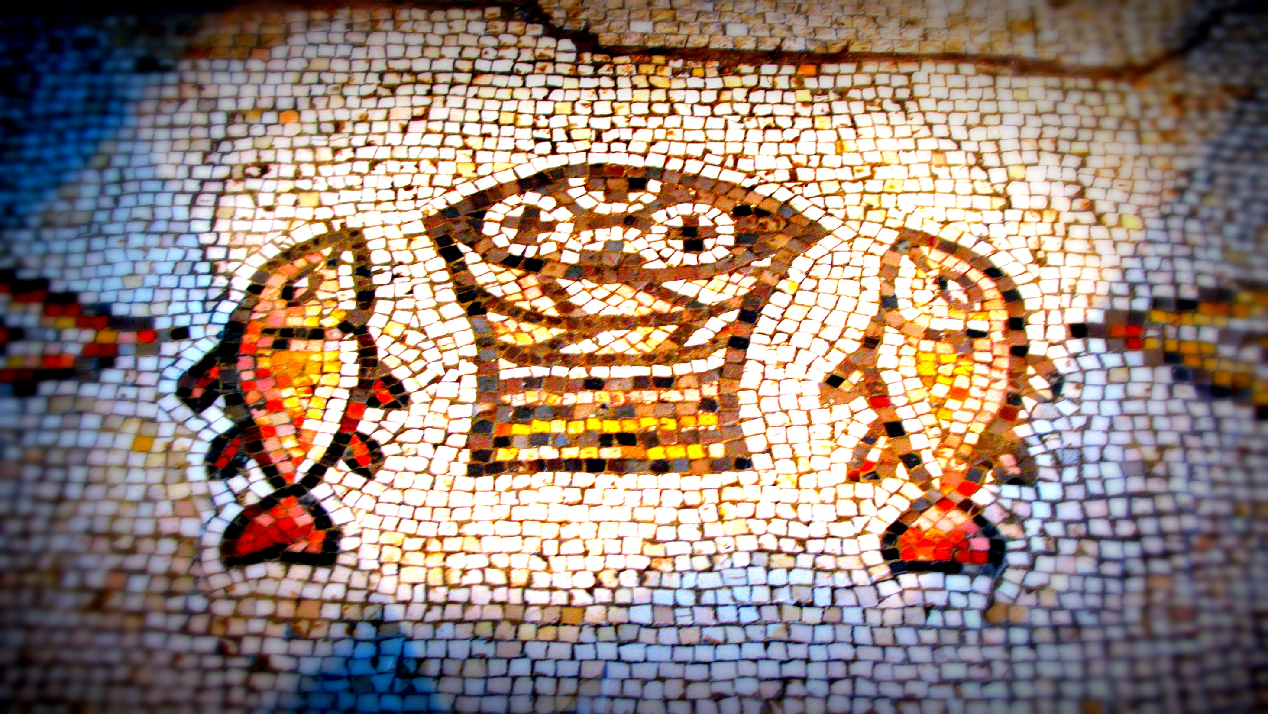
As Temporary Residents Here, We Set Our Hope Fully on the Grace of God
1 Peter 1:13

Slide 6
Fixing Our Hope on Jesus’ Return Encourages Us to Pursue Living a Holy Life
1 Peter 1:14-21

Slide 7
Setting Our Hope

