Slide 1
Solid Foundations in Shaky Times

Slide 2
1 Peter 1:1-2 NASB
1 Peter, an apostle of Jesus Christ, to those who reside as aliens, scattered throughout Pontus, Galatia, Cappadocia, Asia, and Bithynia, who are chosen
2 according to the foreknowledge of God the Father, by the sanctifying work of the Spirit, to obey Jesus Christ and be sprinkled with His blood: May grace and peace be yours in the fullest measure.

Slide 3
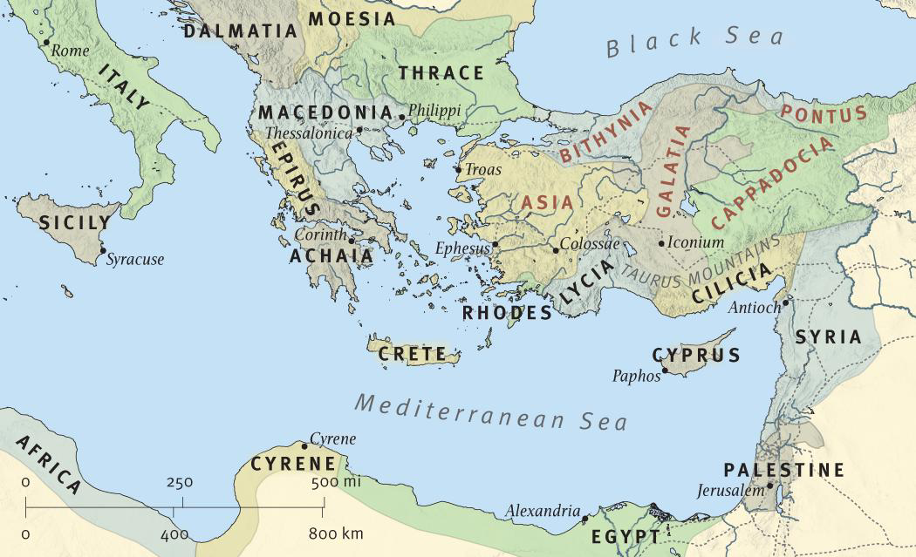
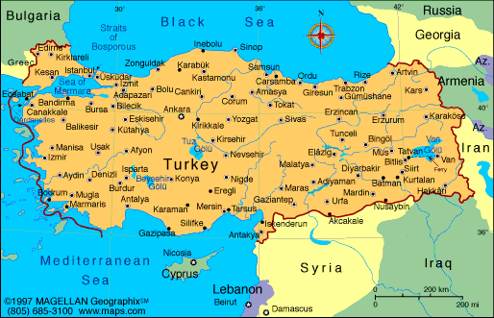

Slide 4
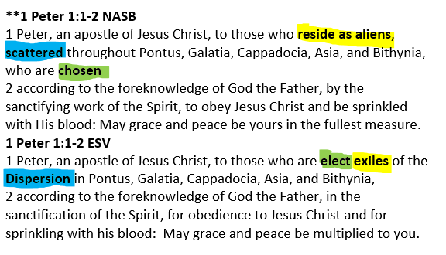

Slide 5
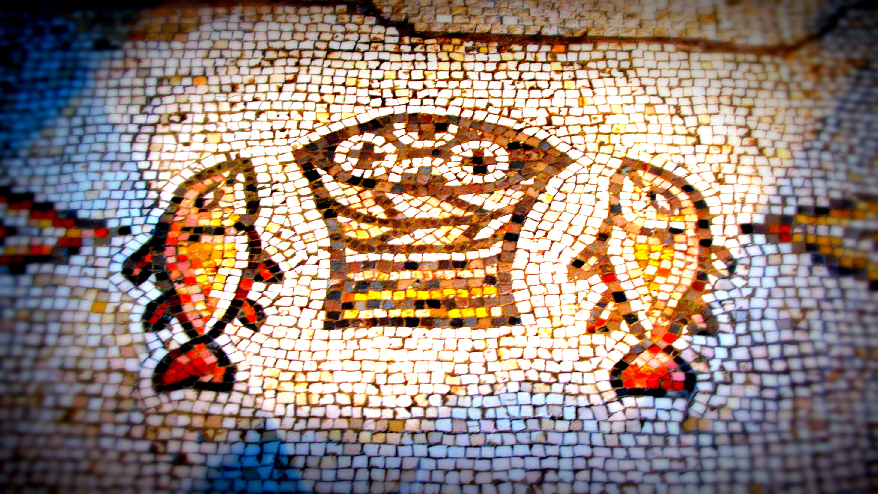
I am forever forgiven and heaven-bound because of what God did
4 Things True of Every Christian

Slide 6
2. I am a resident alien – this is not my
home
4 Things True of Every Christian

Slide 7
3. My brothers & sisters and I are
scattered all over the world for a
reason
4 Things True of Every Christian

Slide 8
4. No matter what happens, God’s
grace will always be enough for my
situation
4 Things True of Every Christian

Slide 9
Solid Foundations in Shaky Times

