Slide 1
eventbrite.com
Search for Celebrating Marriage

Slide 2
How to be a better lover

Slide 3
First, give yourself to God
2 Corinthians 8:5; Romans 12:1-2

Slide 4
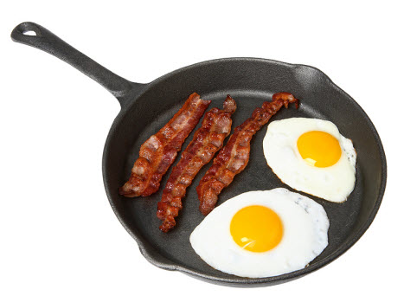
The chicken makes a donation; the pig is committed
Romans 12:1-2

Slide 5
Put yourself in regular fellowship with committed Christ followers
Hebrews 10:24-25

Slide 6
Romans 15:7 Therefore welcome one another as Christ has welcomed you, for the glory of God.
1 Corinthians 12:25 that there may be no division in the body, but that the members may have the same care for one another.
Hebrews 10:24-25

Slide 7
1 Peter 4:10 As each has received a gift, use it to serve one another, as good stewards of God's varied grace:
1 Thessalonians 5:15 See that no one repays anyone evil for evil, but always seek to do good to one another and to everyone.
Hebrews 10:24-25

Slide 8
Ephesians 4:32 Be kind to one another, tenderhearted, forgiving one another, as God in Christ forgave you.
Hebrews 3:13 But exhort one another every day, as long as it is called “today,” that none of you may be hardened by the deceitfulness of sin.
Hebrews 10:24-25

Slide 9
Colossians 3:16 Let the word of Christ dwell in you richly, teaching and admonishing one another in all wisdom, singing psalms and hymns and spiritual songs, with thankfulness in your hearts to God.
Ephesians 5:19 addressing one another in psalms and hymns and spiritual songs, singing and making melody to the Lord with your heart,
Hebrews 10:24-25

Slide 10
Romans 15:14 I myself am satisfied about you, my brothers, that you yourselves are full of goodness, filled with all knowledge and able to instruct one another.
Romans 12:10 Love one another with brotherly affection. Outdo one another in showing honor.
Hebrews 10:24-25

Slide 11
Colossians 3:13 bearing with one another and, if one has a complaint against another, forgiving each other; as the Lord has forgiven you, so you also must forgive.
James 5:16 Therefore, confess your sins to one another and pray for one another, that you may be healed. The prayer of a righteous person has great power as it is working.
Hebrews 10:24-25

Slide 12
1 Peter 4:9 Show hospitality to one another without grumbling.
Hebrews 10:24-25

Slide 13
How to be a better lover

