Slide 1


What’s My Next Step?

Slide 2
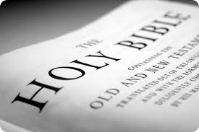
What’s my next step?
Acts 2:42-47
Devotion to one another
All things in common
Love God, Love your neighbor

Slide 3
What’s My Next Steps
Pray
Get intentional in God time
Ask: “If I kept doing what I’ve been doing at Darby Creek, will we reach any more people in our neighborhood for Christ?”
Take a stretching step in finances
Take a stretching step in Bridging Events: Host, Coordinator, Department Head…we’ll coach, teach, train
Overview

Slide 4
Prayer Breakouts
Take your notes
Pray about each piece in your group
Ask for members of your group to follow up and share how you are progressing in next steps

Slide 5
What’s My Next Step?

