Slide 1
Evangelism

Slide 2
Loving God & Loving Our Neighbor Through Evangelism
John 14:21
Whoever has my commandments and keeps them, he it is who loves me. And he who loves me will be loved by my Father, and I will love him and manifest myself to him.

Slide 3
Loving God & Loving Our Neighbor Through Evangelism
Mark 16:15
Go into all the world and proclaim the gospel to the whole creation.

Slide 4
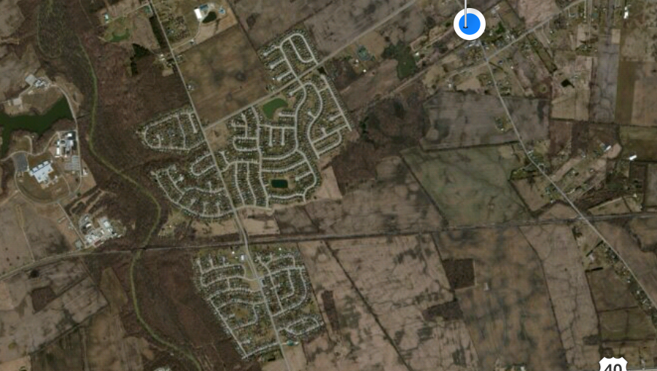

Slide 5
Web Links to Videos Shown
Atheist Gets a Bible
https://www.youtube.com/watch?v=6md638smQd8
Crescent Project on Sharing Christ with Muslims
https://vimeo.com/42229596

Slide 7
Evangelism

