Slide 1
Bridging Events

Slide 2
Bridging Events
1 Corinthians 9:19-23
Being a relevant church
Love God, Love your neighbor

Slide 3
Bridging Events
March 4 or 5 Marriage Seminar
March 25 Good Friday Event
March 19 ? 26? Easter Egg Hunt
April 22 Prayer vigil
June 19 Operation 5:16
Overview
Notes:
Supported by DCCC, but hosted at LRC
Free, licensed screening of Passion of the Christ with some additional touches
Easter Egg hunt rain or shine a la fall festival…will include canvassing, again, along with some prepackaging of gifts – need a coordinator and some staffers
Prayer vigil to be preceded with some prayer walks in communities near us

Slide 4
Operation 5:16
OPERATION
5:16
Let your Light Shine
What is Operation 5:16?
An opportunity for DCCC members to:
- SERVE our neighboring community
- EVANGELIZE and share the good news of Jesus!
- GROW closer together as brothers and sisters
Save the date: June 20-25
Overview

Slide 5
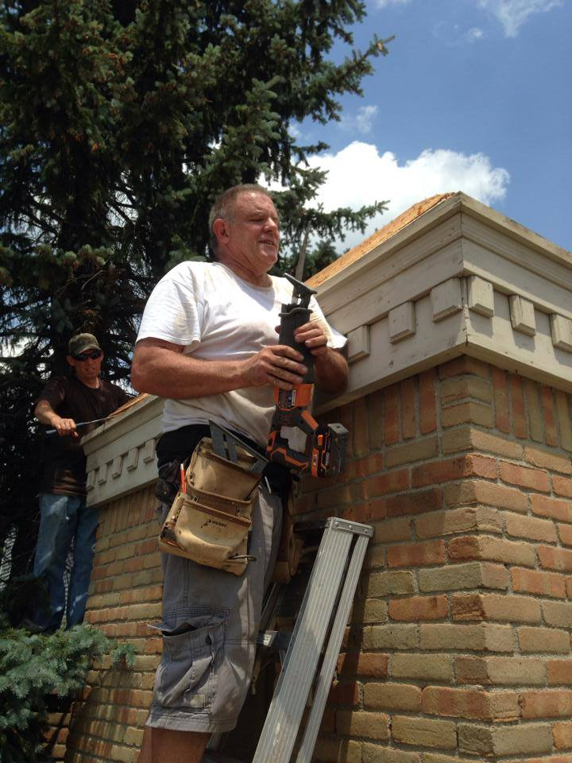
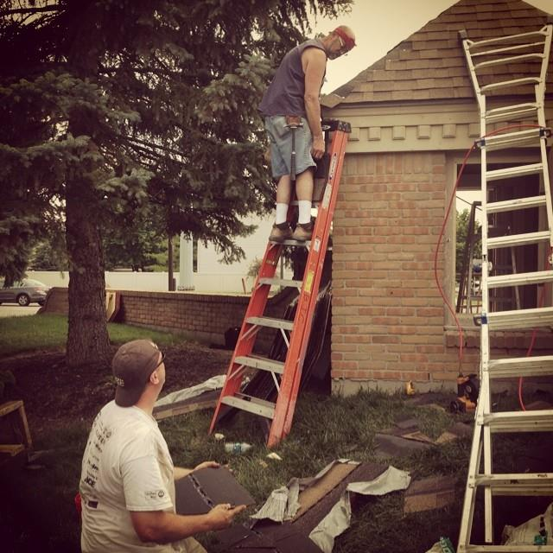
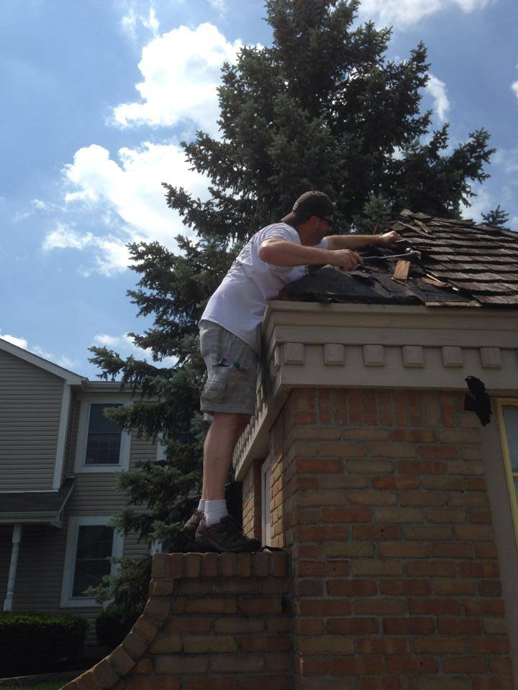
SERVE …in our community
“Let your light shine before men in such a way that they may see your good works, and glorify your Father who is in heaven.” --Matthew 5:16
Operation 5:16

Slide 6
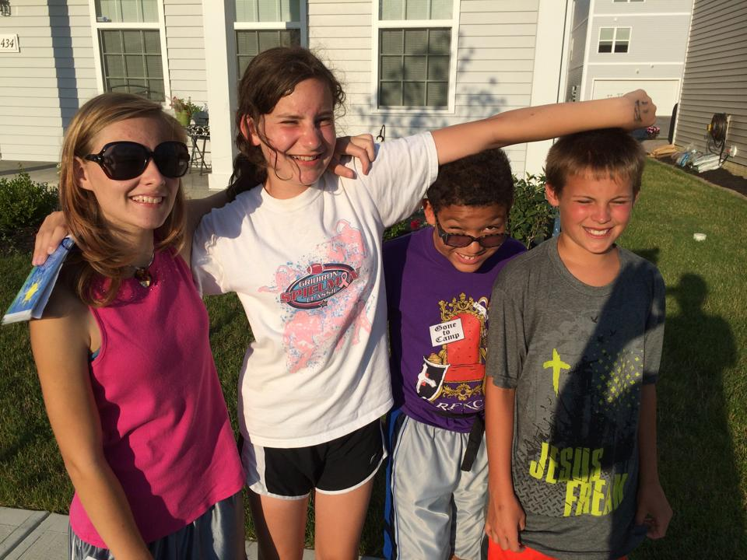
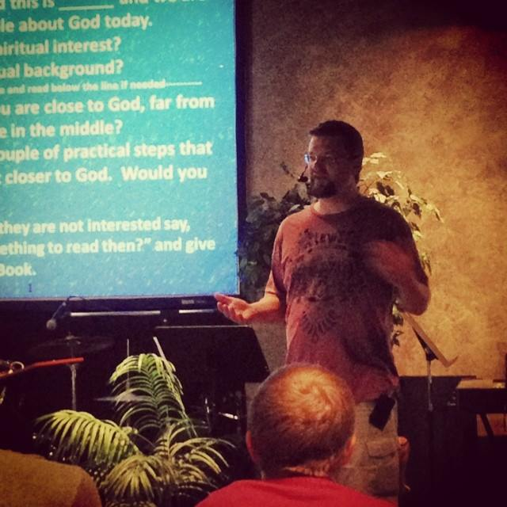
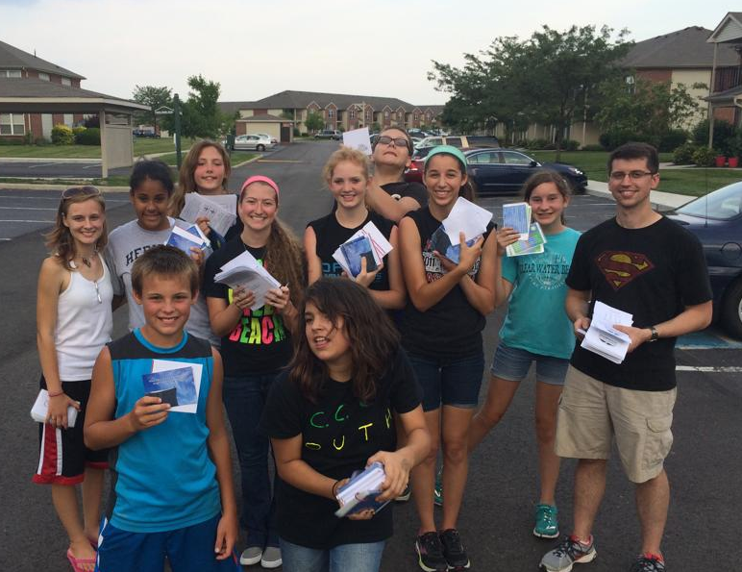
EVANGELIZE …the Gospel is good news!
“For I am not ashamed of the gospel of Christ, for it is the power of God for salvation to everyone who believes…” --Romans 1:16
Operation 5:16

Slide 7
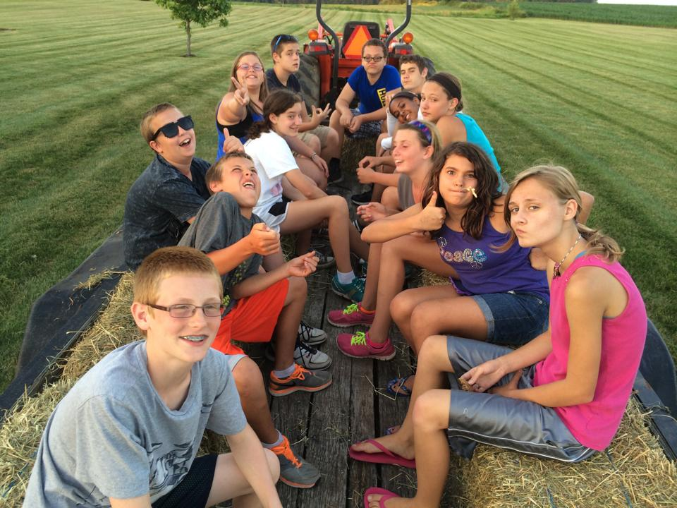
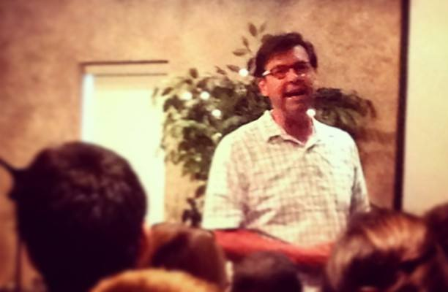
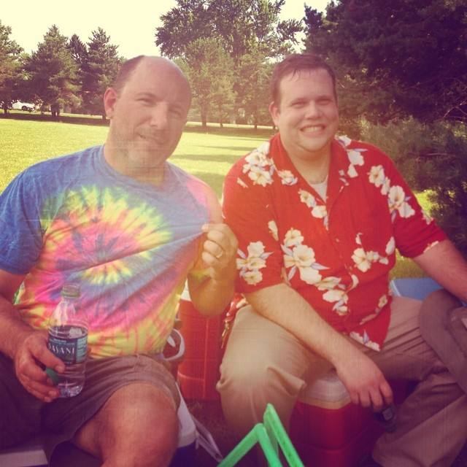
GROW …as a body of believers
“Shout joyfully to the LORD, all the earth. Serve the LORD with gladness; come before Him with joyful singing. Know that the LORD Himself is God; it is He who has made us, and not we ourselves; we are His people and the sheep of His pasture.” --Psalm 100:1-3
Operation 5:16

Slide 8
Schedule
Monday
Tuesday
Wednesday
Thursday
Friday
Serve | Serve | Evangelize | Serve | Serve
Bible Study | Bible Study | Evangelism Training | Bible Study | Big Project w/Adults
Lunch | Lunch | Lunch | Lunch | Lunch
Project | Project | Prayer Walk | Project | Big Project w/Adults
Break/Activity | Break/Activity | Break/Activity | Summer Party | Camping Trip
Dinner | Dinner | Dinner
Worship and Teaching Night | Worship and Teaching Night | Praise and Prayer Night
Operation 5:16
these can move, switch, rotate, repeat

Slide 9
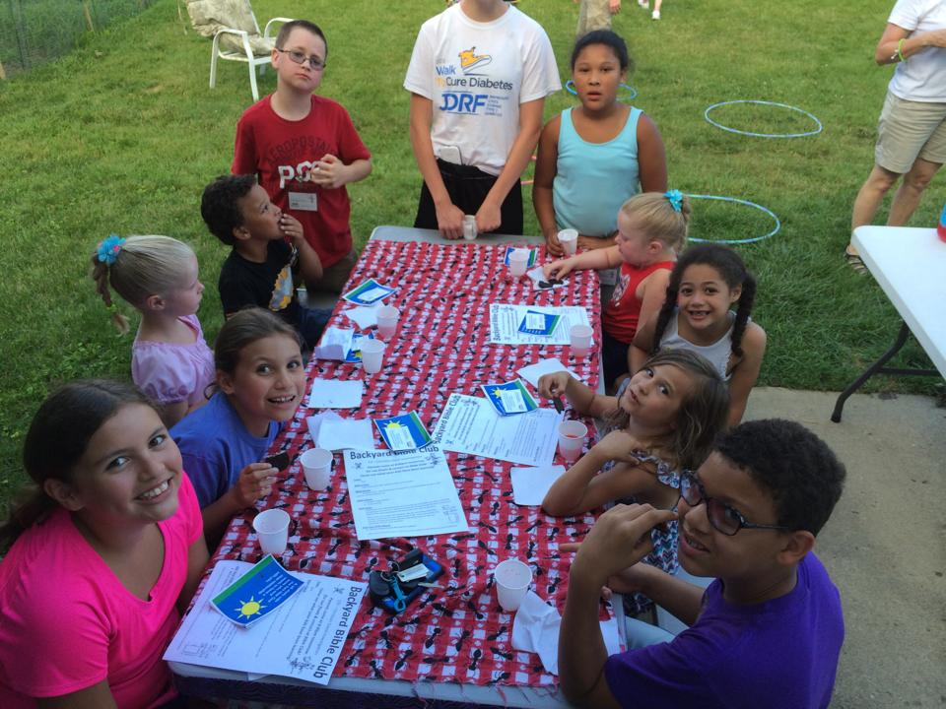
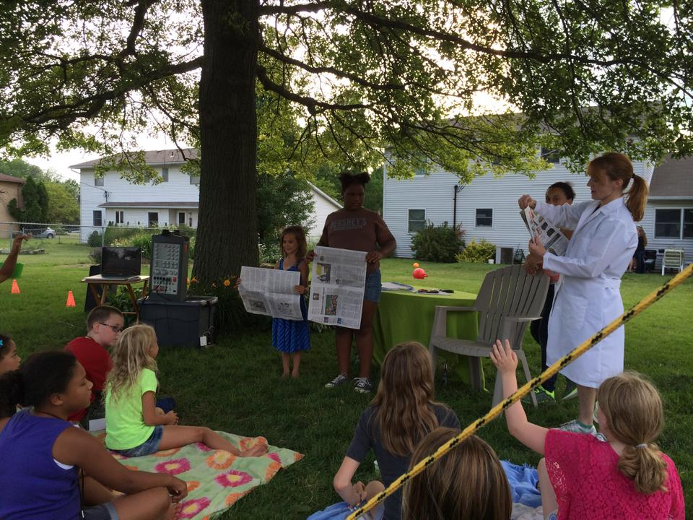
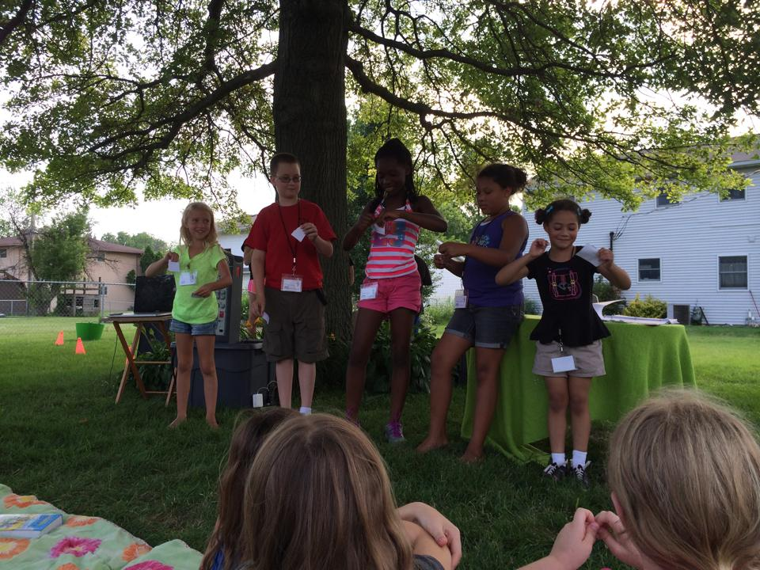
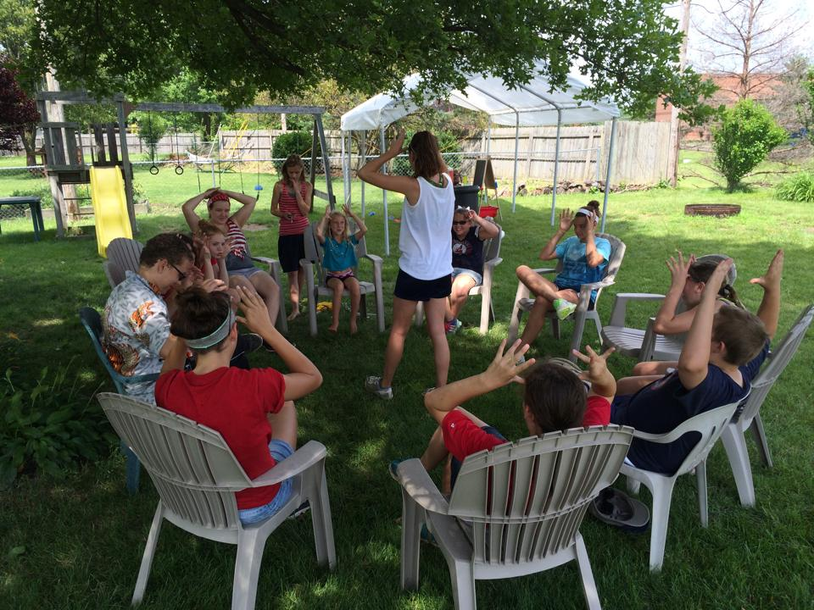
Backyard Bible Club
Also planning Backyard Bible Club for neighboring community to run concurrently
Operation 5:16

Slide 10
Needs
Be praying to serve as:
- Project coordinator
- Meal coordinator
- Backyard Bible Club coordinator
- Evening event leader
- Music coordinator
- Technology coordinator
- Communications manager
- Camping coordinator
Operation 5:16
Prayer for:
- Location
- Leaders
- Daily topics/themes
- Projects
- God’s Will

Slide 11
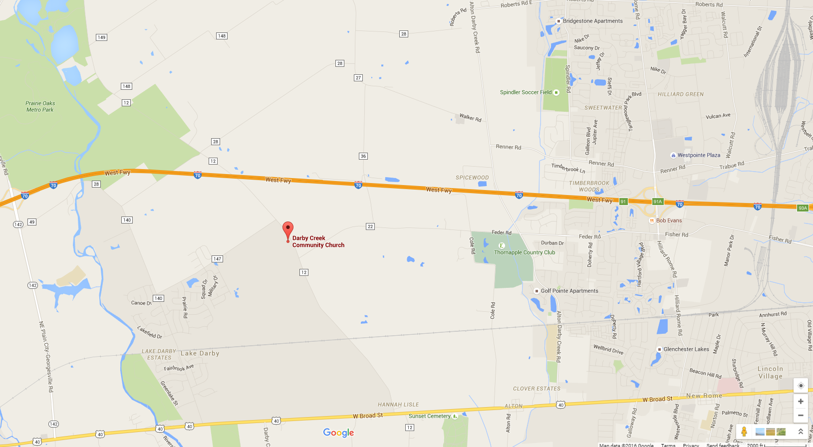
Community …and House of Peace
Also need a “House of Peace”
- Two-car garage
- Usable basement
- Nice yard
- Park nearby
Operation 5:16

Slide 12
Social Media
Find us on the web at:
http://www.operation516.darbycreek.org
Operation 5:16
https://www.facebook.com/operation516
https://twitter.com/Operation516
http://instagram.com/operation516

Slide 13
Bridging Events
March 18 Marriage Seminar
March 25 Good Friday Event
March 19 ? 26? Easter Egg Hunt
April 22 Prayer vigil
June 19 Operation 5:16
July 4th weekend Picnic/ OP5:16 follow up
July 9-15 Life Training, NC
July-August Sunday Picnics
October 22? 29? Fall Festival
November Craft Show?
Overview
Notes:
Supported by DCCC, but hosted at LRC
Free, licensed screening of Passion of the Christ with some additional touches
Easter Egg hunt rain or shine a la fall festival…will include canvassing, again, along with some prepackaging of gifts – need a coordinator and some staffers
Prayer vigil to be preceded with some prayer walks in communities near us
Nick slides
Follow up pic nic at op 5:16 host home for neighborhood
HS and college
Pic nics
Fall festival, we actually have a pretty good play book to blow the dust off and execute. Need a director for pre-event communication; recruiting helpers; coordinating collections; etc

Slide 14
Bridging Events

