Slide 1
As people are arriving and getting settled, please take a few minutes to complete the survey you were given as you came in. They will be collected at the end of the meeting or you can put your completed survey in the box before the meeting starts.
Survey

Slide 2
State of the Church & Vision Meeting
January 30, 2016

Slide 3
A Look Back At Church Events
2015

Slide 4
Baptism

Slide 5
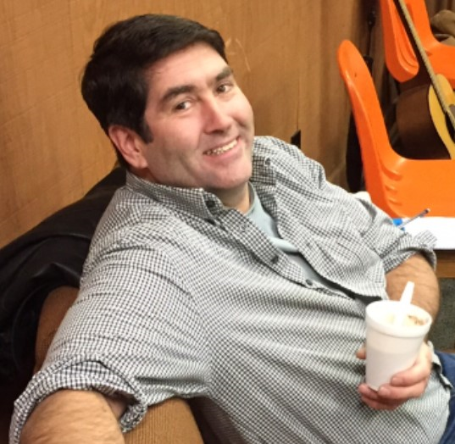
Men’s Retreat

Slide 6
Pizza Outreach

Slide 7
Child Dedication

Slide 8
Child Dedication

Slide 9
Youth Group

Slide 10
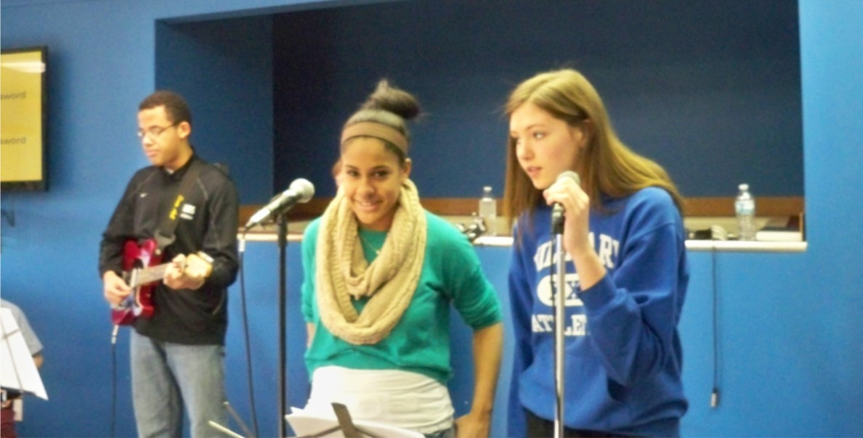
Kick

Slide 11
Kick

Slide 12
Nicaragua

Slide 13
Nicaragua

Slide 14
Worship Night

Slide 15
Sunday Picnics

Slide 16
LT

Slide 17
LT

Slide 18
New Infant Room

Slide 19
New Toddler/Pre-school Room

Slide 20
Fall Festival

Slide 21
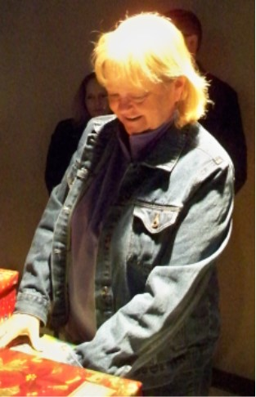
OCC

Slide 22
Women’s Cookie Experience

Slide 23
Christmas Eve Service

Slide 24
Event List
Prayer & Praise Gathering Baptism
Faithwalkers One Thing Bible Plan
Class 101 Men’s Retreat
Pizza Outreach Child Dedication
Ladies Breakfast Good Friday Experience
12 Hour Prayer Vigil Nicaraguan Missions
Clean Up Day Ice Cream Social
Worship Night Summer Picnics
Leadership Training New Child Care Rooms
School Supply Collection Craft Show
Fall Fest OCC
Service Broadcast Christmas Eve

Slide 25
Financial Update
Snapshot of our finances

Slide 26
Account Balances as of 1/27/2016
Operating Fund $25,930.07
Needs Fund $7,580.72
Building Fund $120,098.45

Slide 27
Monthly Income from Tithes

Slide 28
2014-15 Ministry Year
Income:
Budgeted $207,900.00
Actual $209,412.89
-----------------------------------
($1,512.89)
Expenses:
Budgeted $207,874.00
Actual $208,317.60
----------------------------------
($443.60)
Net Income of $1,069.29
Income and Expenses

Slide 29
2015-16 Ministry Year So Far
Income:
Budgeted $70,160.00
Actual $77,048.77
-----------------------------------
($6888.77)
Expenses:
Budgeted $70,160.00
Actual $71,937.19
----------------------------------
($1,777.19)
Net Income of $5,111.58

Slide 30
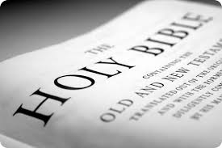
Please write down any questions you have and give them to an Elder
Continue Our Daily Time in God’s Word!

